Slide 1
GM Quarterly Economic Review Q1 2024
Subrahmaniam Krishnan-Harihara
Deputy Director - Research & Information Systems GM Chamber
26th March 2024

Slide 2
Welcome & Introduction
Quarterly Economic Briefing
Chris Fletcher, Policy Director
QES presentation
Subrahmaniam Krishnan-Harihara, Deputy Director – Research & Information Systems
Sponsor presentation
Keri Barton, Group Sales & Marketing Director, WTA
Panel discussion and Q&A
Keri Barton
Susana Cordoba, Head of International Trade,
Subrahmaniam Krishnan-Harihara,
Chaired by: Chris Fletcher
#GMEconomics for tweets

Slide 3
Where is the Quarterly Economic Survey (QES)?
The Greater Manchester QES is part of the UK’s largest and most reliable business confidence survey
GM Chamber administers the survey in GM and co-ordinates the North West QES, which goes to the BCC.
National QES results are used by the likes of HM Treasury, Bank of England and OECD for decision making.
GM QES is the primary source of economic intelligence in Greater Manchester.
The findings are presented to the Greater Manchester Combined Authority's Economic Resilience Group and the 10 councils in GM for local decision making.
From the QES results, we calculate the GM Index^{TM,} a composite economic indicator for the GM Economy.
#GMEconomics

Slide 4
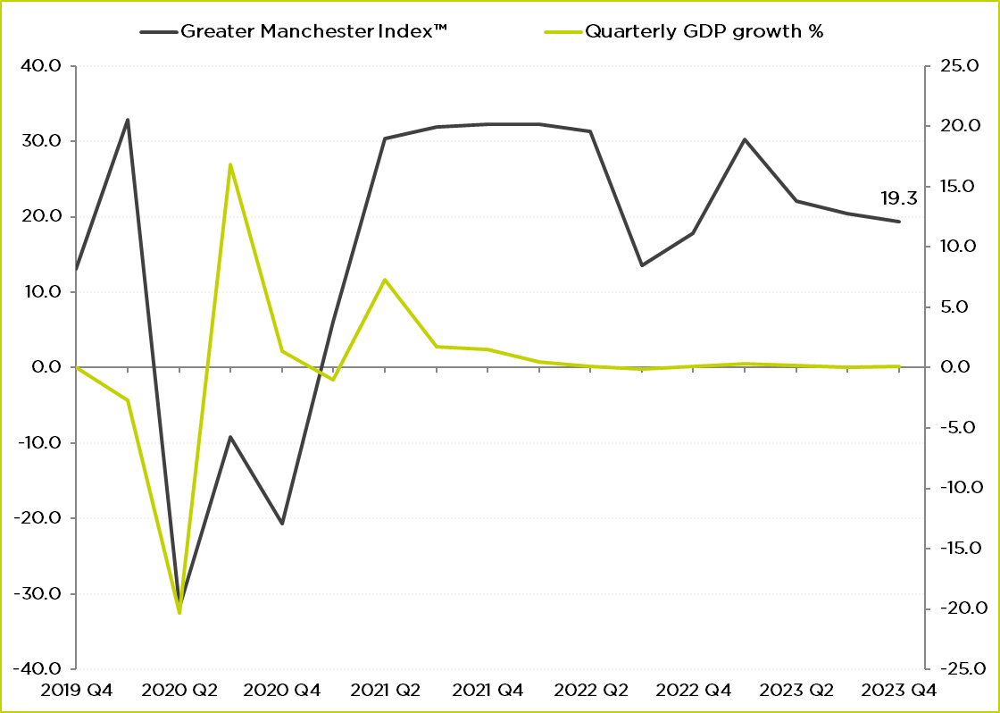
Where were we last quarter?
GM Index in Q4 2023 was 19.3, a drop of 1.1 points from Q3.
“Stagnation nation”.
Source: GMCC QES, ONS GDP Quarter on Quarter growth: CVM SA %
#GMEconomics

Slide 5
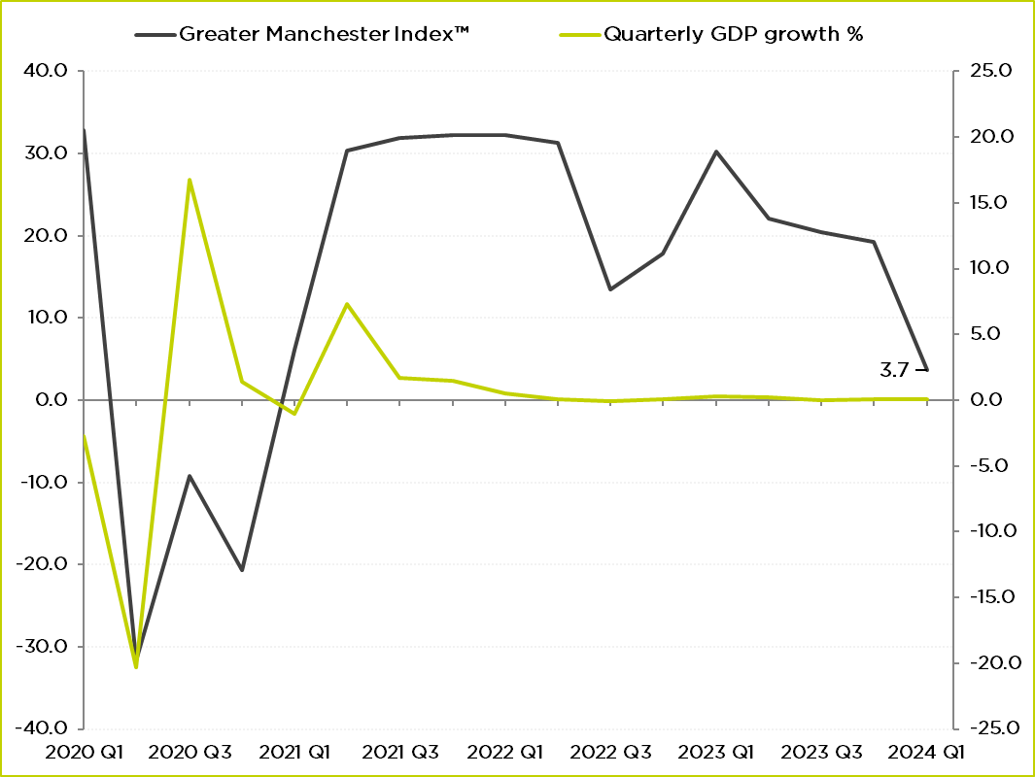
Where are we now?
GM Index in Q1 2024 is 3.7, down nearly 16 points.
0.1% growth in 2023.
0.2% in January 2024
GfK consumer confidence:
-19 in January and -21 in February and March (-36 in March 2023)
PMI indices¹ in March:
Construction: 49.7↑
Manufacturing: 47.5 ↑
Services: 53.8↓
Source: GMCC QES, ONS GDP Quarter on Quarter growth: CVM SA %
¹ Levels above 50 indicate growth
#GMEconomics

Slide 6
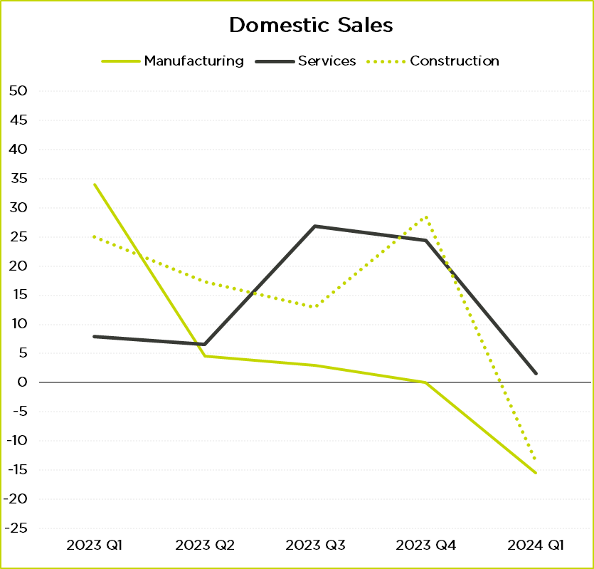
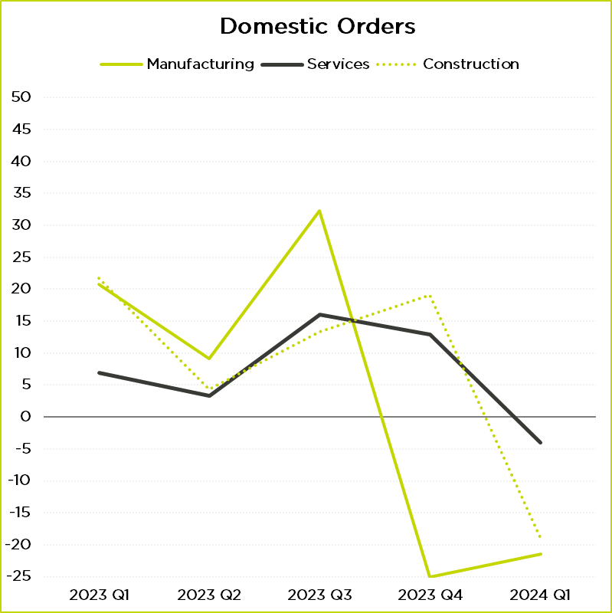
Domestic Demand
Source: GMCC QES
#GMEconomics

Slide 7
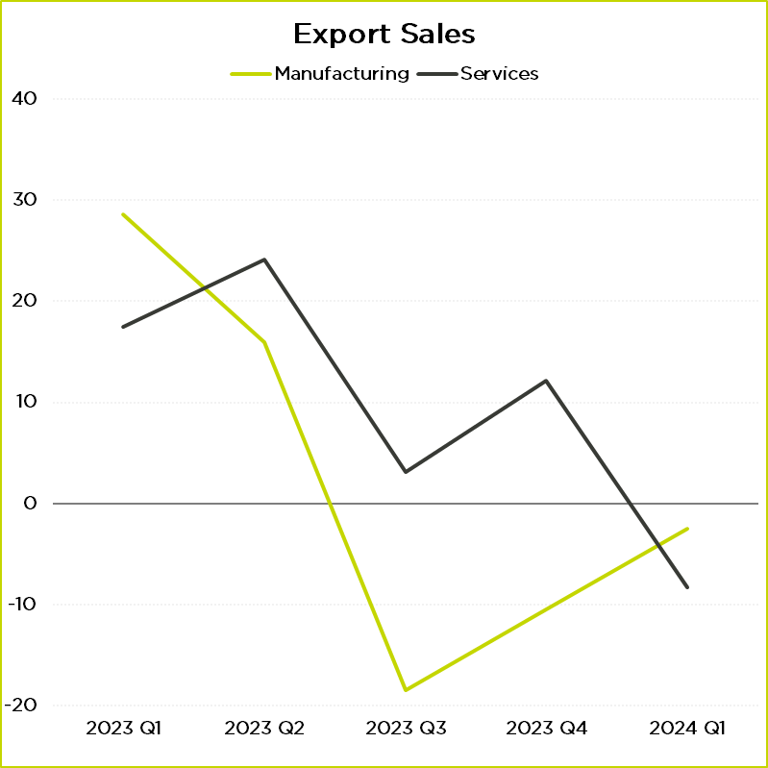
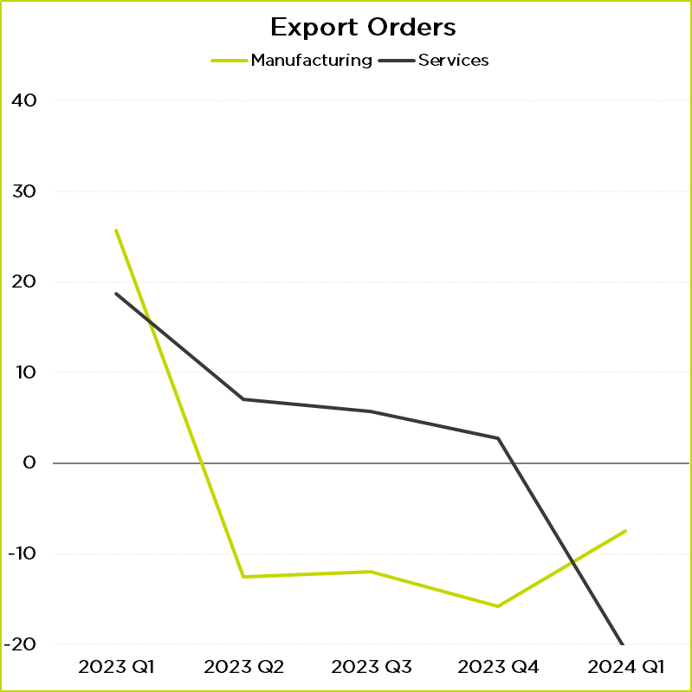
Overseas Demand
Source: GMCC QES
#GMEconomics

Slide 8
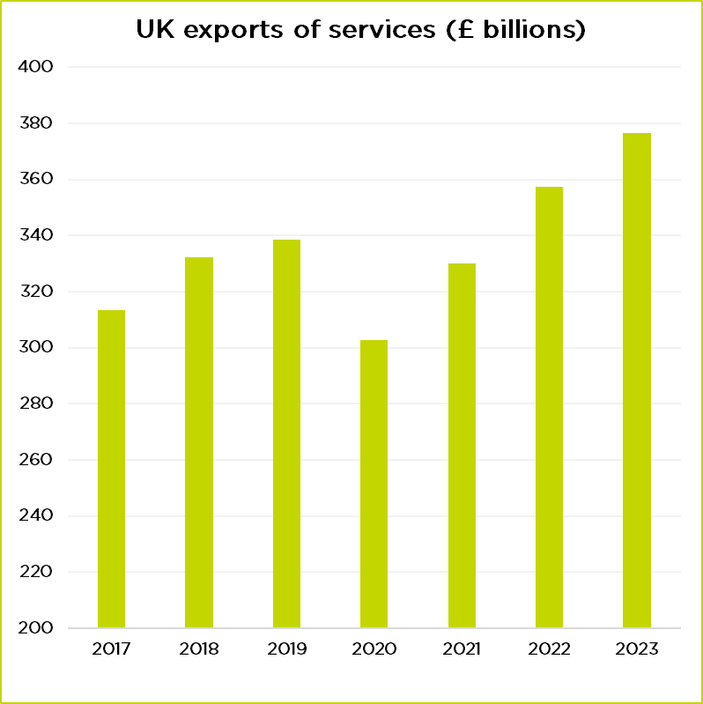
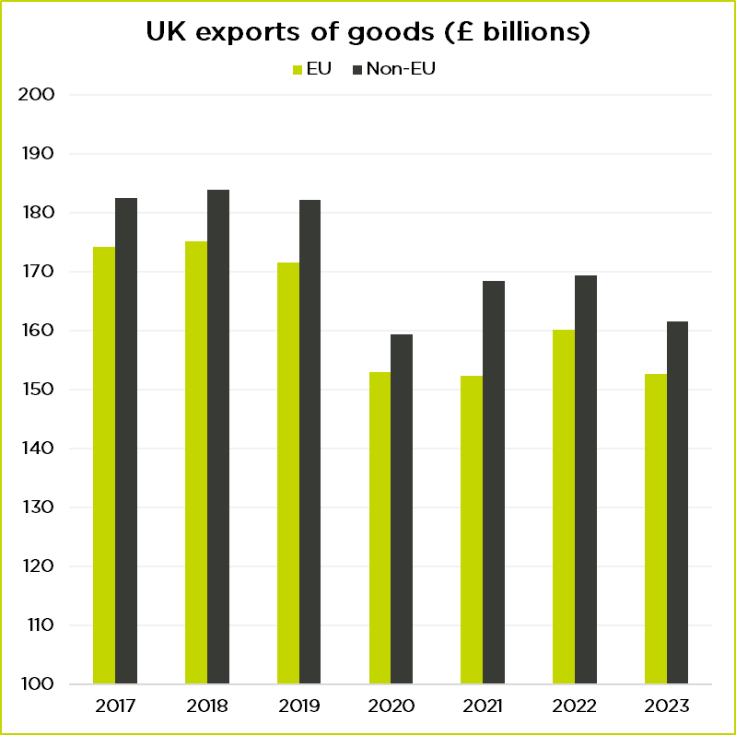
UK International Trade
Source: ONS
#GMEconomics

Slide 9
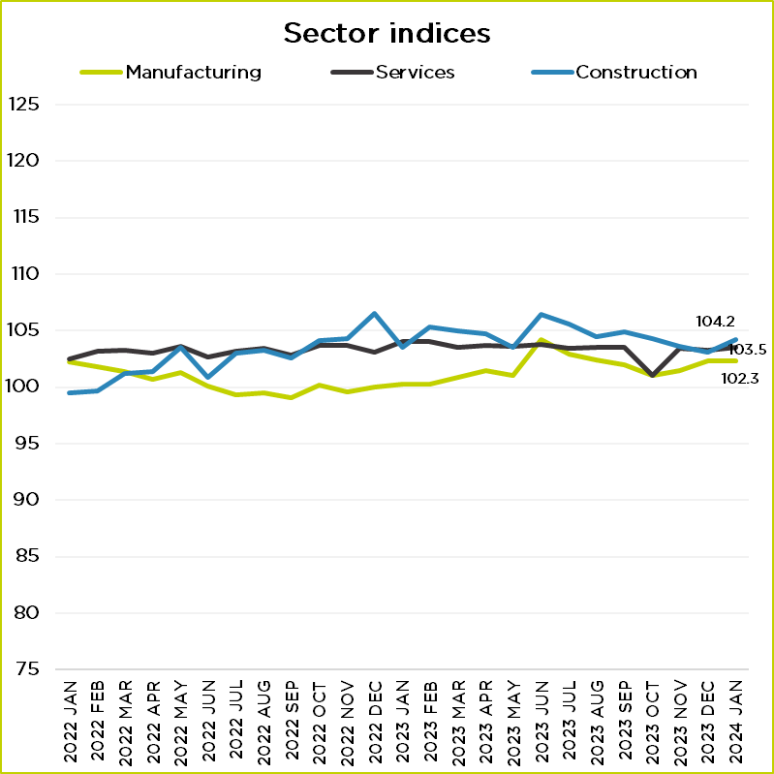
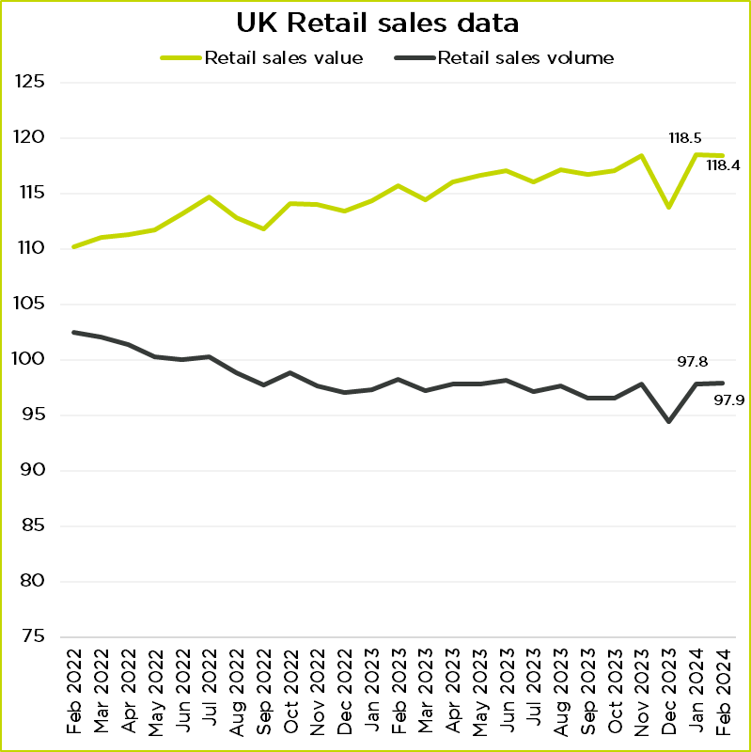
UK Sector Performance
Source: ONS
Source: ONS
#GMEconomics

Slide 10
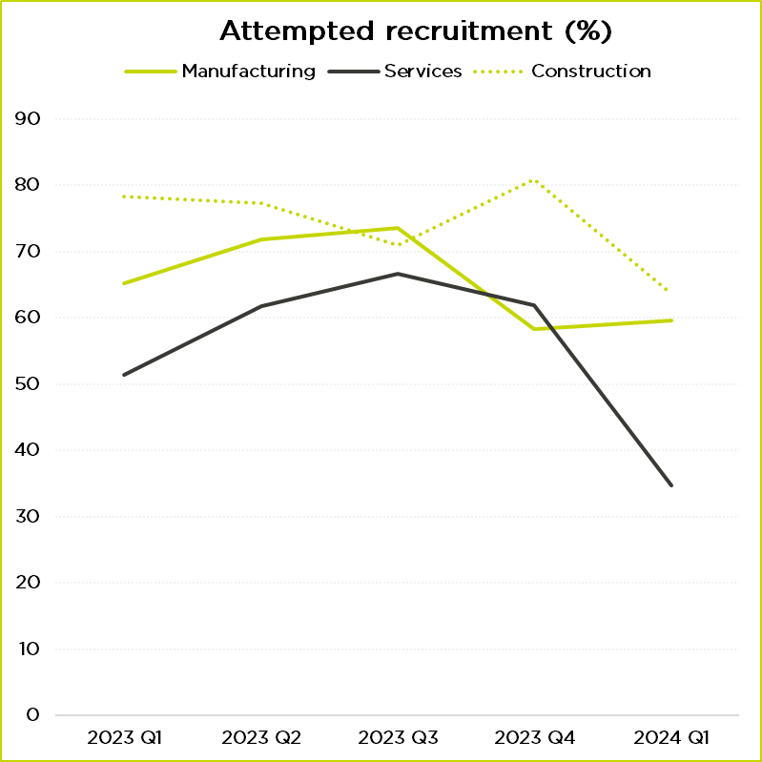
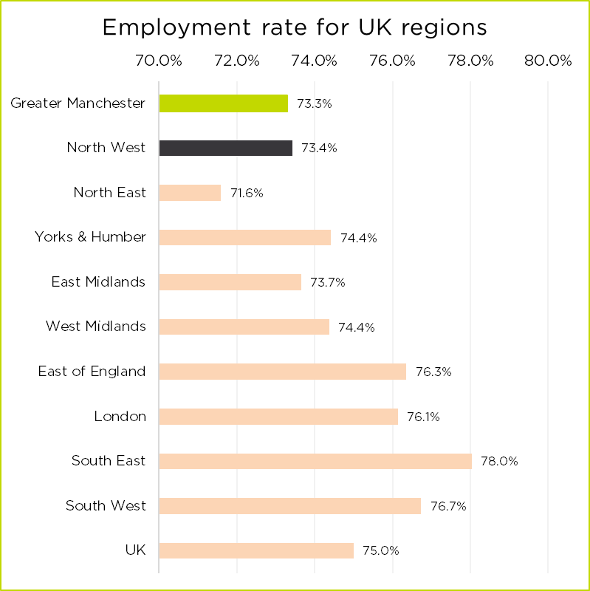
Recruitment
Source: ONS Business Insights and Conditions Survey
#GMEconomics

Slide 11
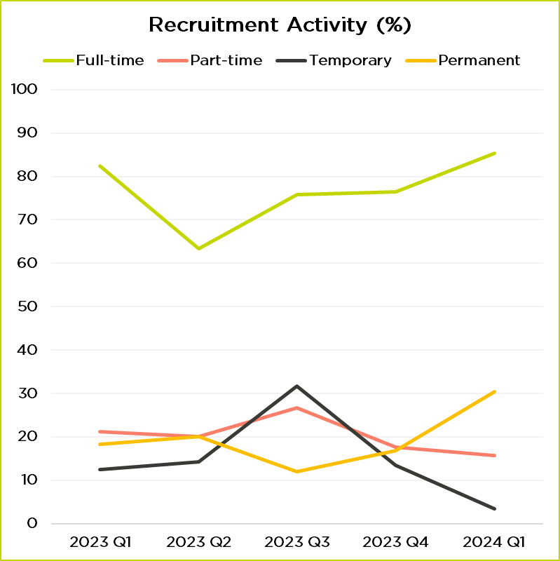
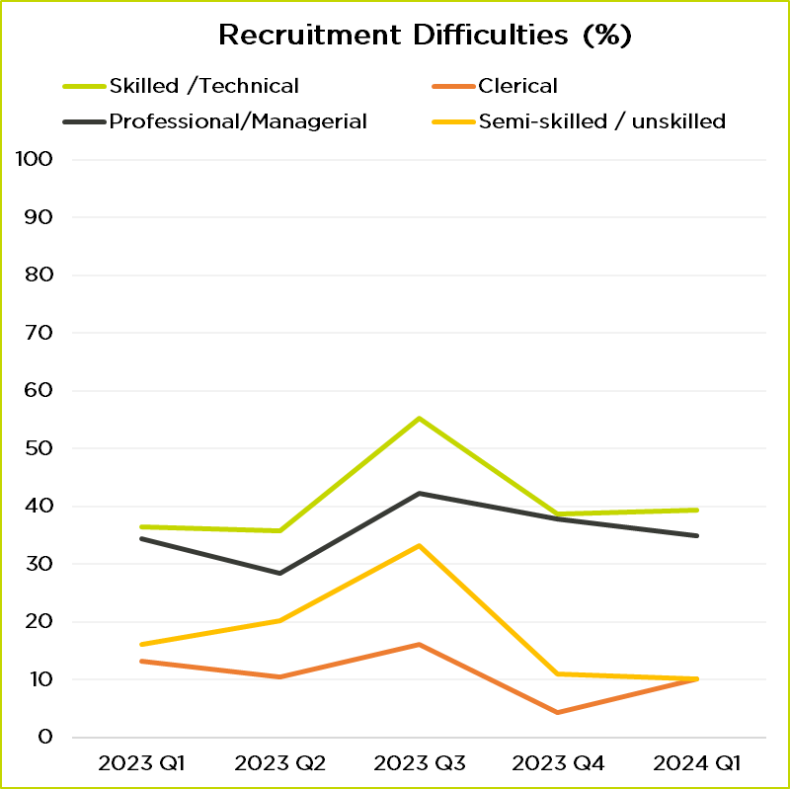
Recruitment
Source: GMCC QES
Source: ONS Labour market in the regions of the UK: February 2024
#GMEconomics

Slide 12
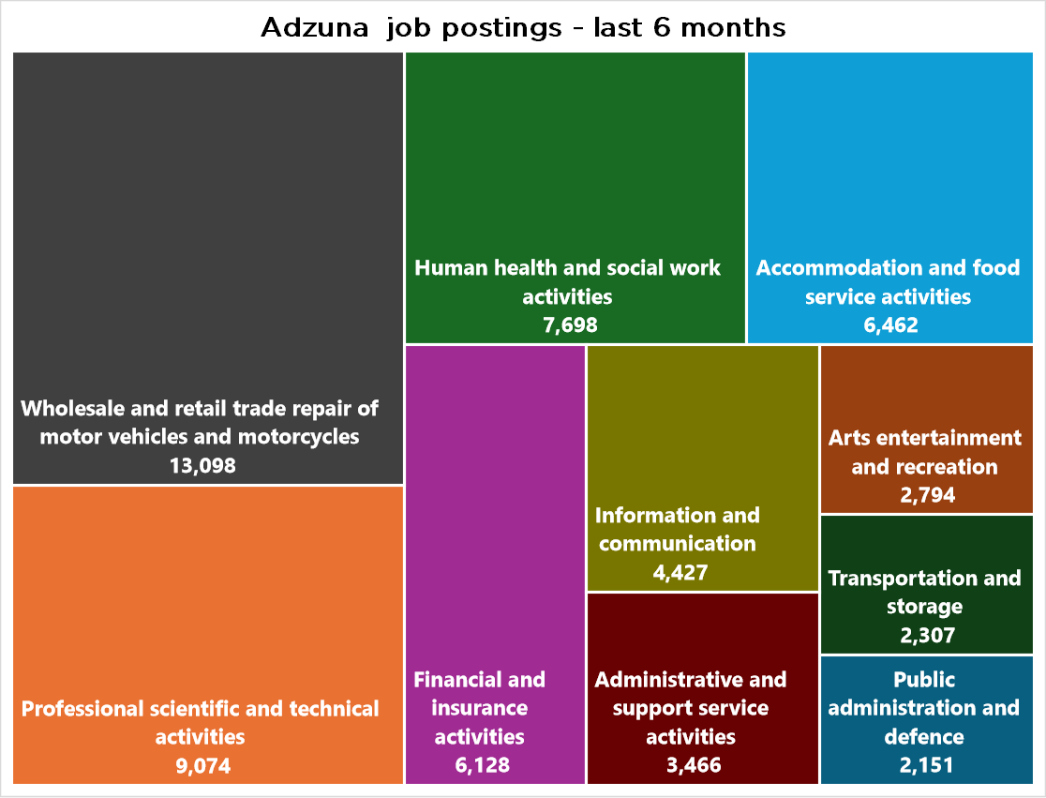
Labour Market Information
In the last six months, 255,000 jobs were advertised in GM
There were 3,570 postings for apprenticeships, an increase of 13% relative to Q2.
The median salary is now £32,395, a 6.2% increase from a year ago.
Lots of openings for teaching assistants, SEN assistant, project managers, software developers
Source: Adzuna
#GMEconomics

Slide 13
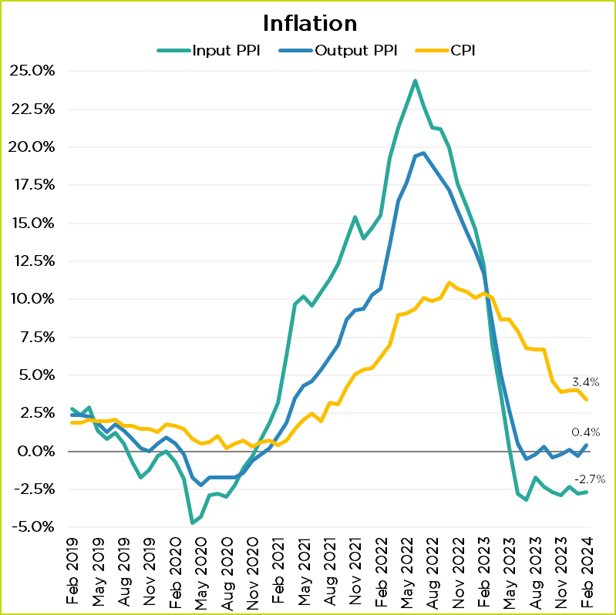
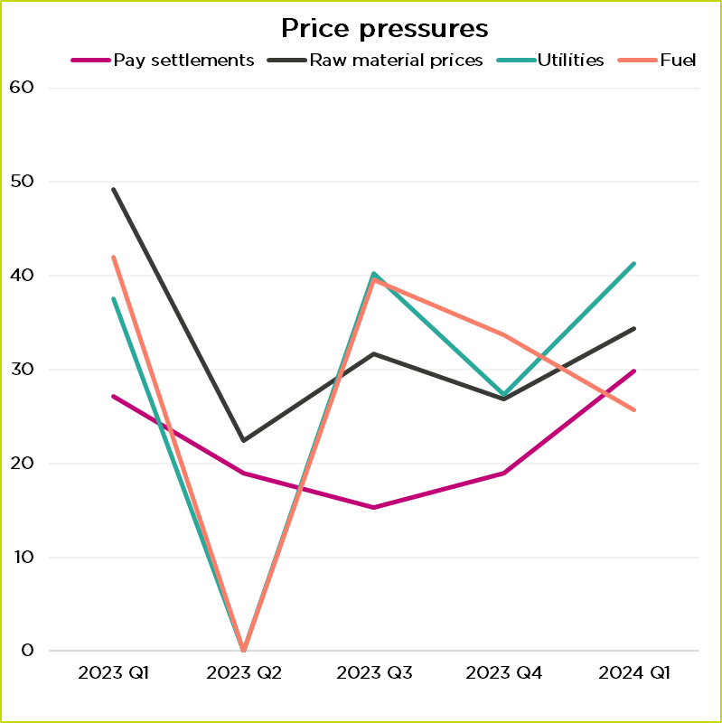
Inflation and price pressures
Source: ONS CPI, PPI data
Source: GMCC QES
#GMEconomics

Slide 14
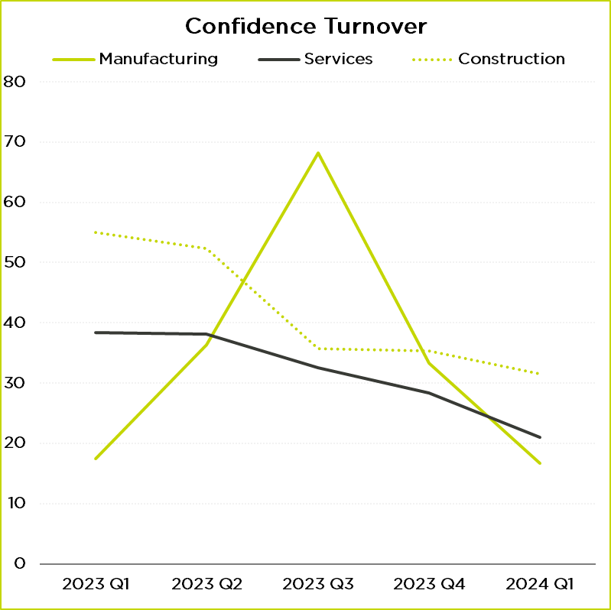
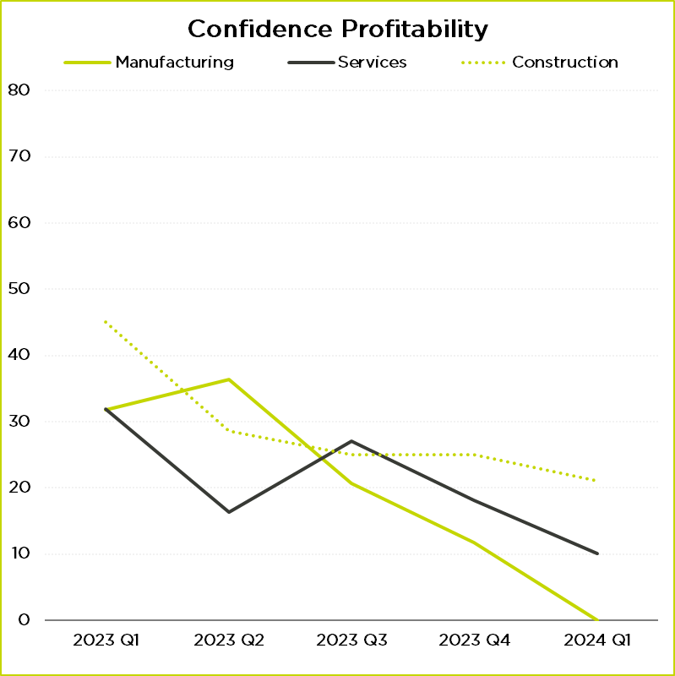
Business Confidence
Cash positions have improved in two quarters in a row for services and manufacturing. Capacity utilisation remains stable.
Source: GMCC QES
#GMEconomics

Slide 15
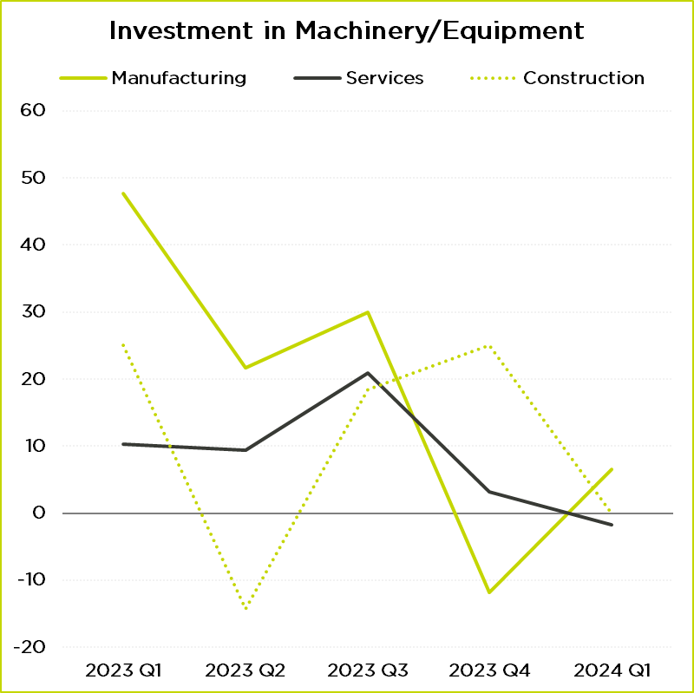
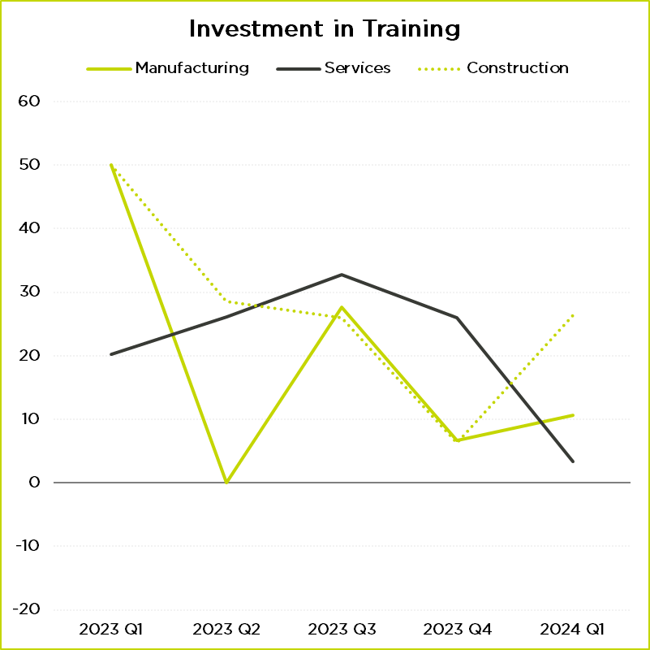
Business Investment
Cash positions have improved in two quarters in a row for services and manufacturing. Capacity utilisation remains stable.
Source: GMCC QES
#GMEconomics

Slide 16
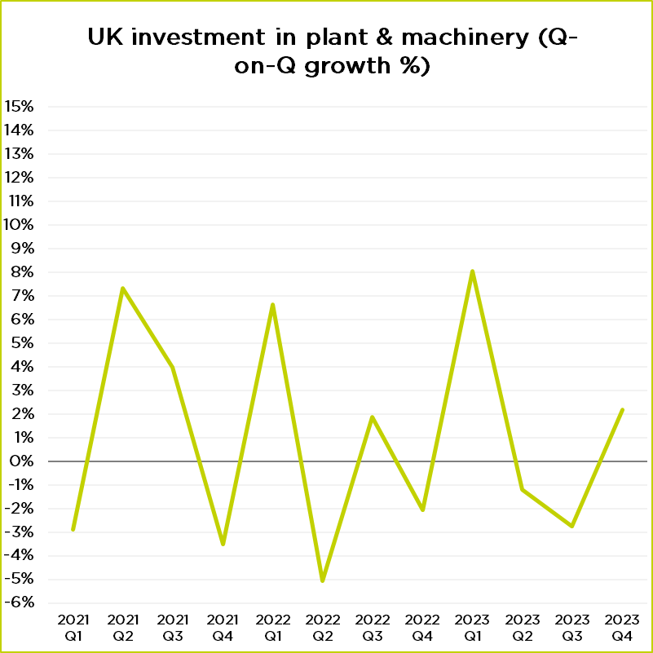
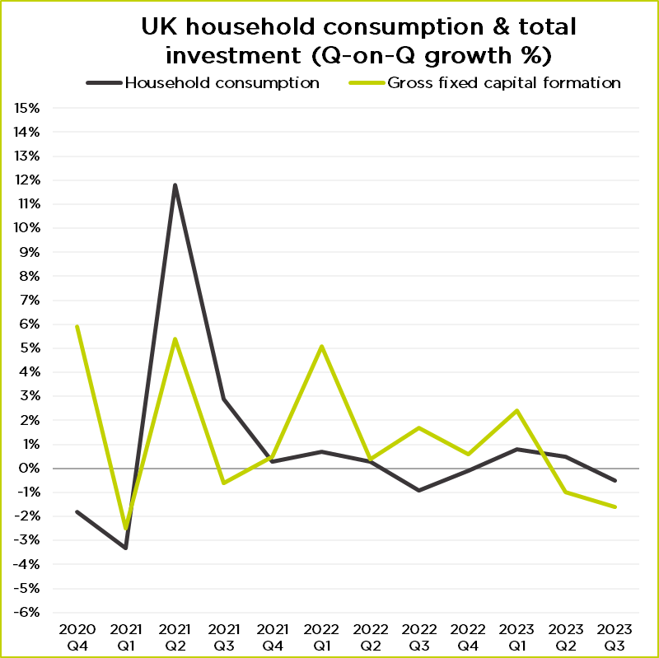
UK Investment
Cash positions have improved in two quarters in a row for services and manufacturing. Capacity utilisation remains stable.
Source: ONS GDP data
Source: ONS GDP data
#GMEconomics

Slide 17
Summary & GDP Forecast
There are many economic challenges: lows levels of demand, cashflow pressures, lower levels of business confidence.
The latest Budget cut personal taxes but not business taxation. There aren’t enough additional measures to increase investment.
Inflation has started to ease, and energy bills are going down in April. Consumer spending could increase in Q2. In the GfK consumer confidence index, perception of general economic situation has improved.
Economy will continue to show low levels of growth.
Forecast growth for 2024: 0.5% to 0.8%.
#GMEconomics

Slide 18
Sponsor presentation
Keri Barton
Sales & Marketing Director, WTA
#GMEconomics

Slide 19
Logistics
Review Q1 24.
A look at how the Red Sea crisis is impacting the global economy.
Logistics doesn’t have to be a maze.

Slide 20
About me (from our website)
Keri is dedicated to ensuring our customers' experience, service and communications with WTA remain market leading, and through innovation continues to set the benchmark for customer service and product innovation in logistics.
Keri Barton,
Sales & Marketing Director, WTA
My 3 passions in life:
My children
Manchester United
Assisting UK businesses with their international logistics strategy.

Slide 22
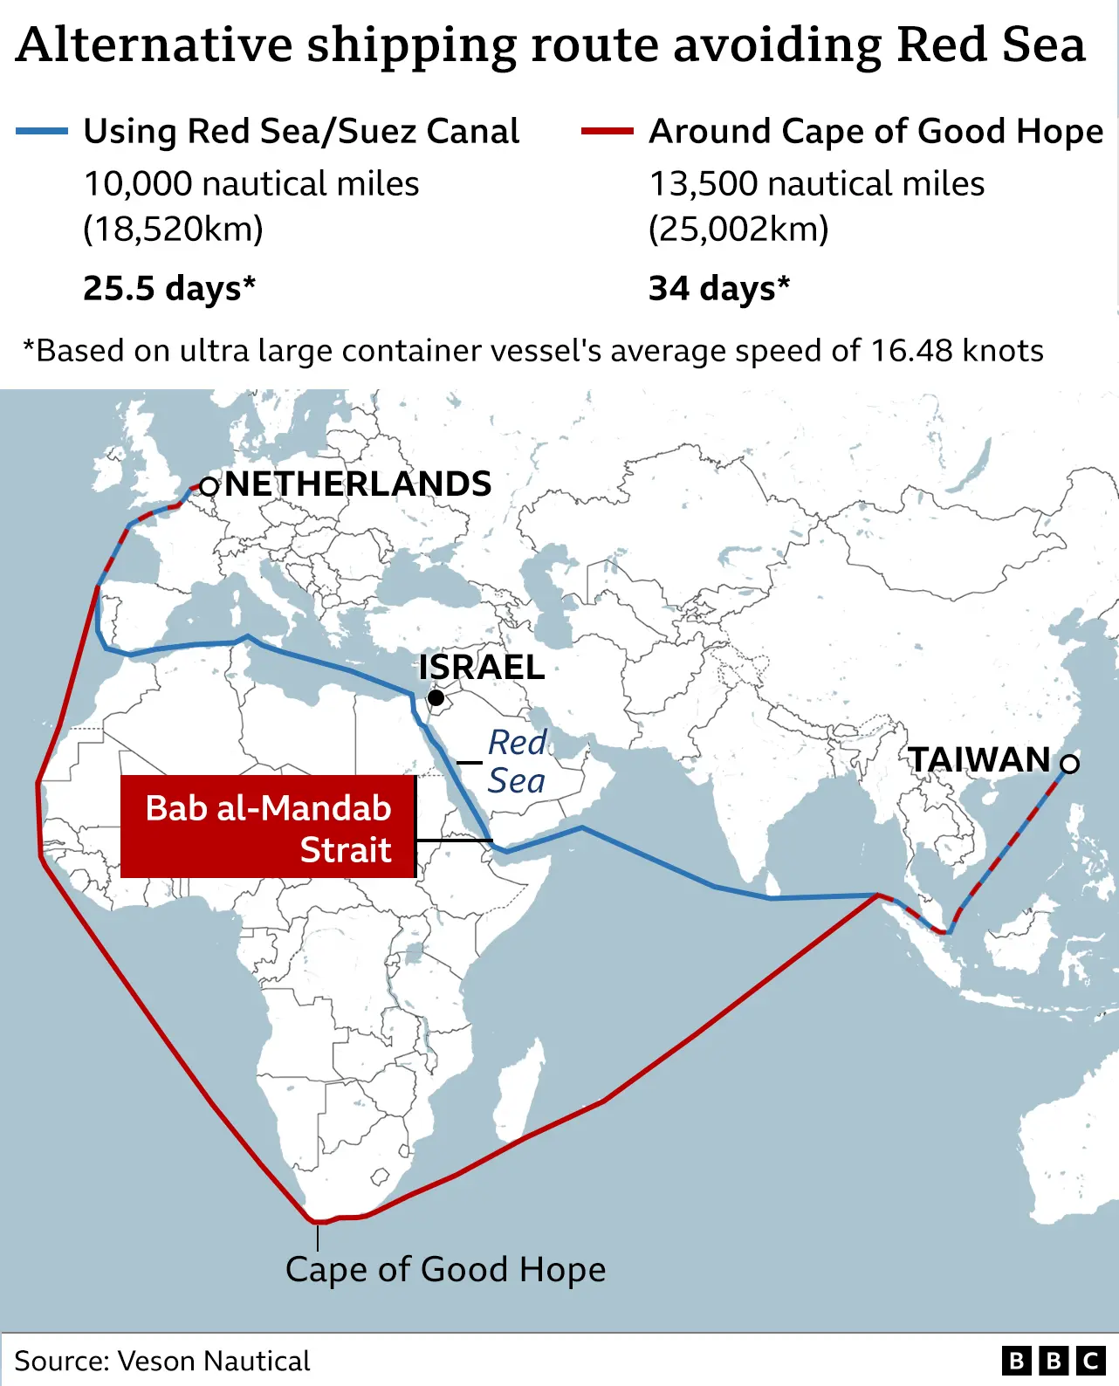
Recap.
All major carriers avoiding the Red Sea for safety reasons.
Massive increase in short term freight rates.
20% of global trade flows through region.
Adds 10-15 days onto transit times from China – Europe. Increased floating inventory.
Schedules knocked off-sync. Delays and surcharges.
1.5-2 million teu effectively taken out the market.
Chinese New Year intensified issues.
37% of surveyed firms say they’ve been impacted.
Source: BCC

Slide 23
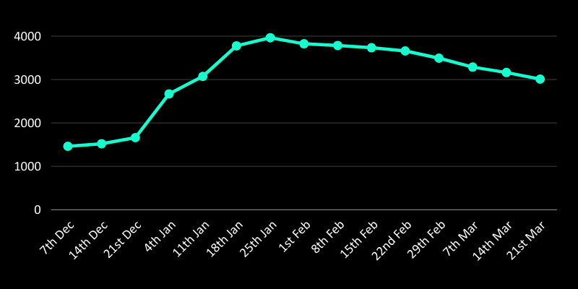
Red Sea Crisis Economic Impact.
Drewry Container Index for East-West Trade Routes
Diversion widely anticipated to be in place for the long term.
Higher and unpredictable freight costs are providing inflationary pressure, estimated to be 0.4%.
Oil price trending upwards since mid-December.
Road haulage sector passing increased fuel costs to businesses.
Air freight demand and rates on the increase.
Super election year uncertainty.
World Container Index assessed by Drewry averages actual spot container freight rates for 8 major east-west trade routes. All are reported in USD per 40ft Container.

Slide 24
Solutions
Stay informed.
Supply chain visibility
Supplier diversification

Slide 25
Phone number
Email address
Website
+44 (0)161 493 1160
info@wtagroup.com
www.wtagroup.com

Slide 26
Thank you!
Panel discussion / Q&A
#GMEconomics

