Slide 1

GM Quarterly Economic Briefing Q4 2024
Subrahmaniam Krishnan-Harihara
Deputy Director - Research & Information Systems GM Chamber
18th December 2024

Slide 2
Welcome & Introduction
Quarterly Economic Briefing
Chris Fletcher, Policy Director
QES presentation
Subrahmaniam Krishnan-Harihara, Deputy Director – Research & Information Systems
Chris Jackson, MD, TransPennine Express
Susana Cordoba, Head of International Trade, GMCC
Subrahmaniam Krishnan-Harihara
Chaired by: Chris Fletcher
Panel discussion and Q&A
#GMEconomics for tweets

Slide 3
What is the Quarterly Economic Survey (QES)?
The Greater Manchester QES is part of the UK’s largest and most reliable business confidence survey
GM Chamber administers the survey in GM and co-ordinates the North West QES, which goes to the BCC.
National QES results are used by the likes of HM Treasury, Bank of England and OECD for decision making.
GM QES is the primary source of economic intelligence in Greater Manchester.
The findings are presented to the Greater Manchester Combined Authority's Economic Resilience Group and the 10 councils in GM for local decision making.
From the QES results, we calculate the GM Index^{TM,} a composite economic indicator for the GM Economy.
#GMEconomics

Slide 4
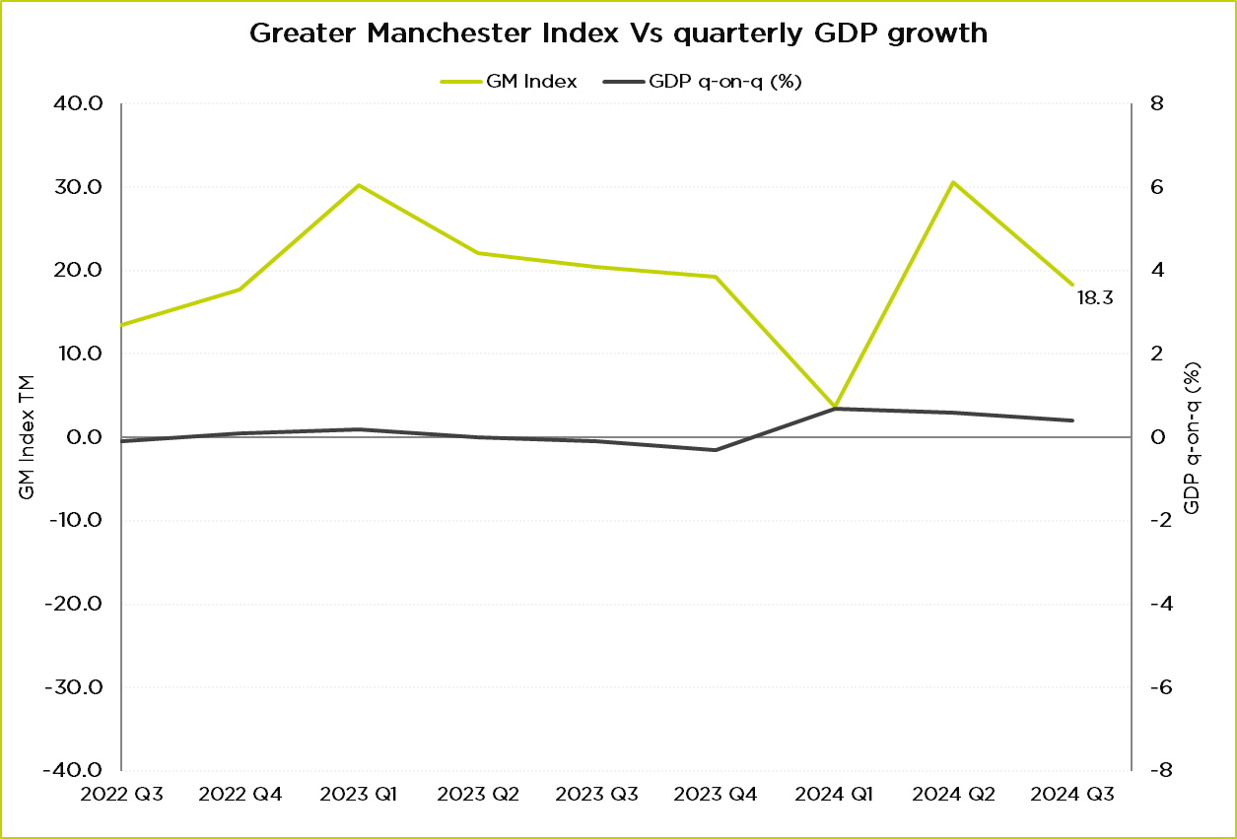
Where were we in Q3?
GM Index in Q3 2024: 18.3
Noticeable quarterly slowdown relative to Q2.
Consumer confidence dipped in September after 6 months of improvement.
Source: GMCC QES, ONS GDP Quarter on Quarter growth: CVM SA %
#GMEconomics

Slide 5
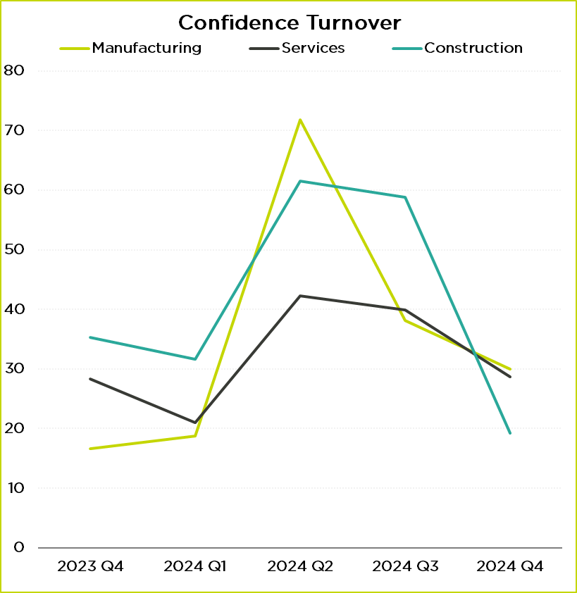
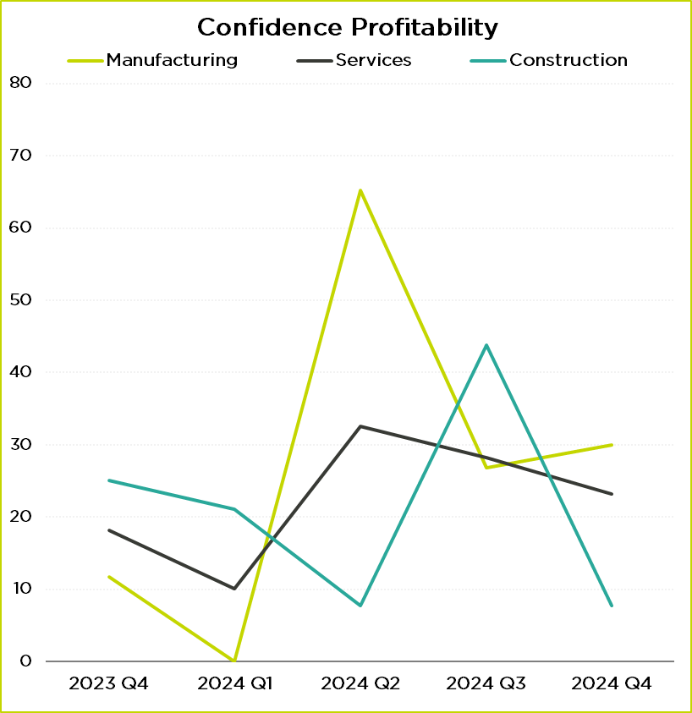
Business Confidence
Source: GMCC QES
Source: GMCC QES
#GMEconomics

Slide 6
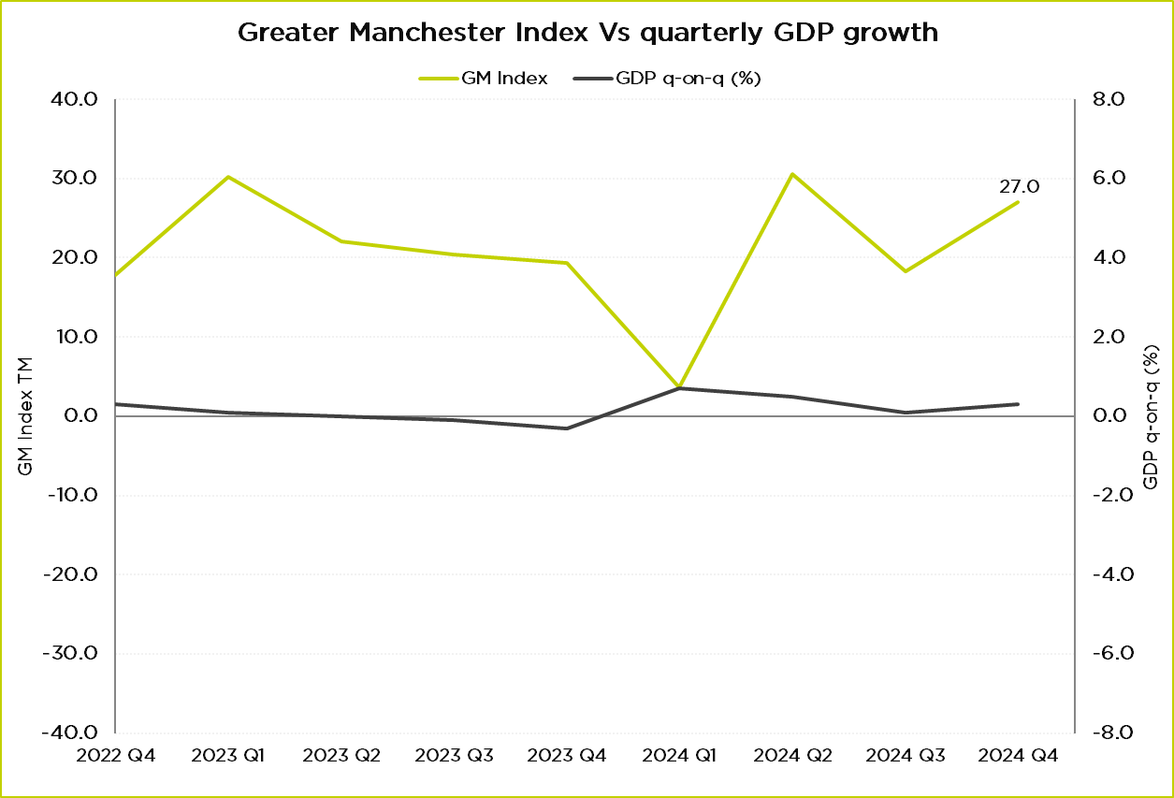
Where are we now?
GM Index in Q4 2024: 27.0
Improvement in both domestic and international demand
Q3 GDP growth of 0.4%
Latest PMI indices show a mixed picture
  Services 50.8
  Manufacturing 48
  Construction 55.2
0.1% growth in Aug to Oct 2024 (monthly reductions of 0.1% in Sep and Oct).
Source: GMCC QES, ONS GDP Quarter on Quarter growth: CVM SA %
#GMEconomics

Slide 7
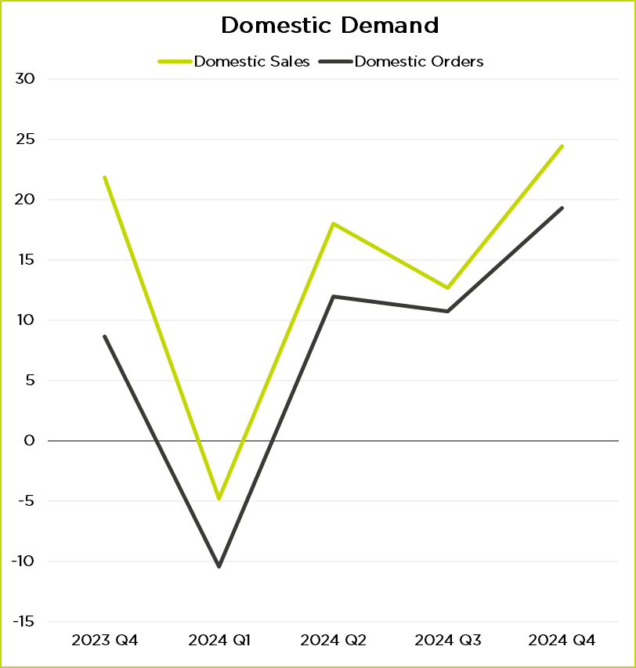
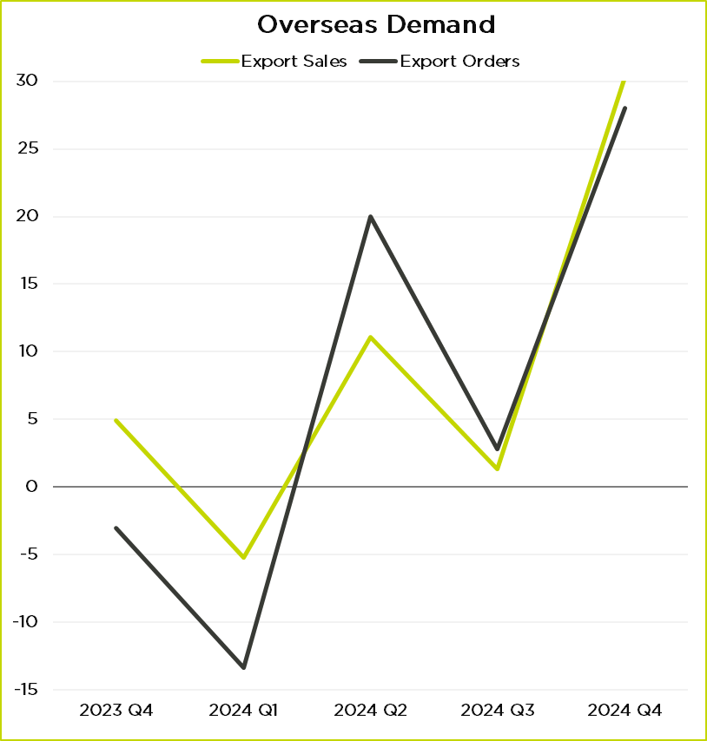
Customer Demand
Source: GMCC QES
Source: GMCC QES
#GMEconomics

Slide 8
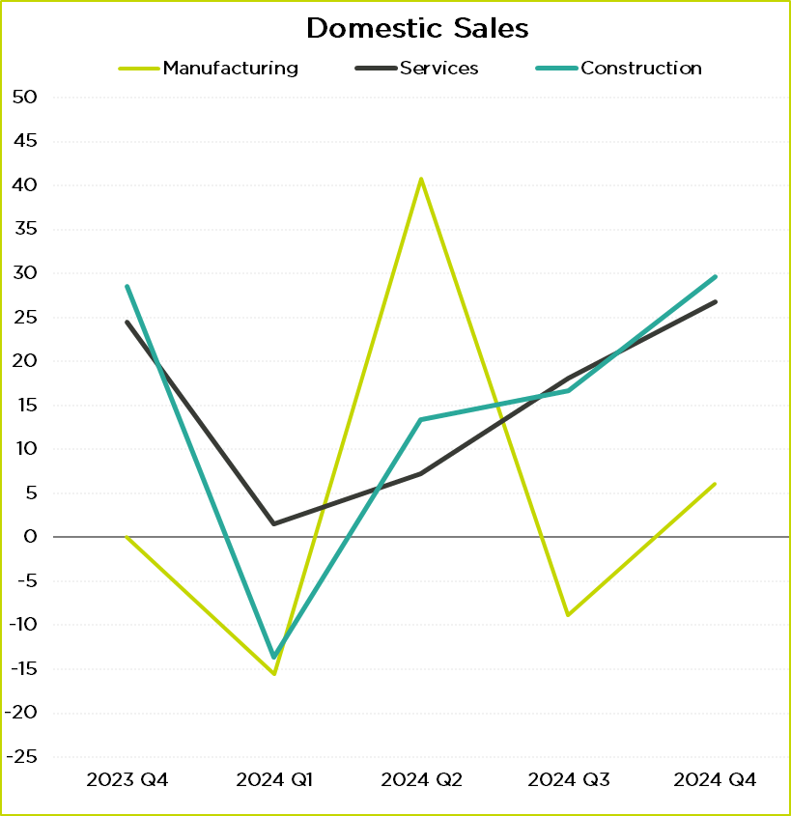
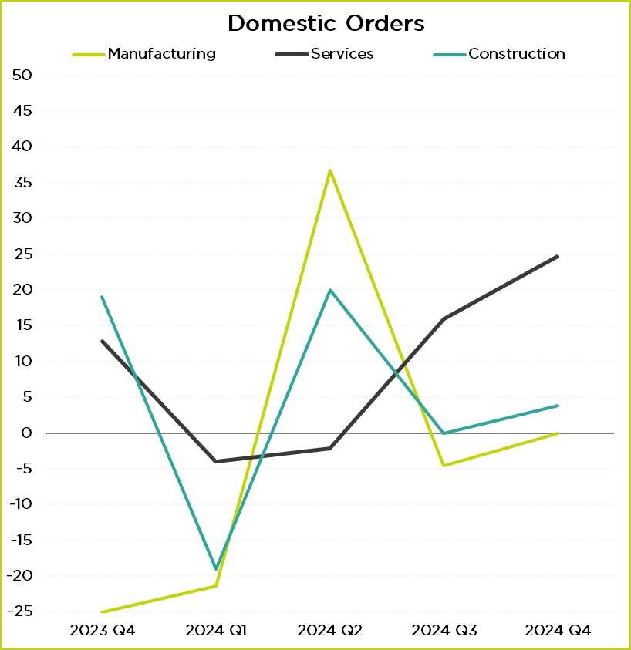
Domestic Demand: sectoral
Source: GMCC QES
Source: GMCC QES
#GMEconomics

Slide 9
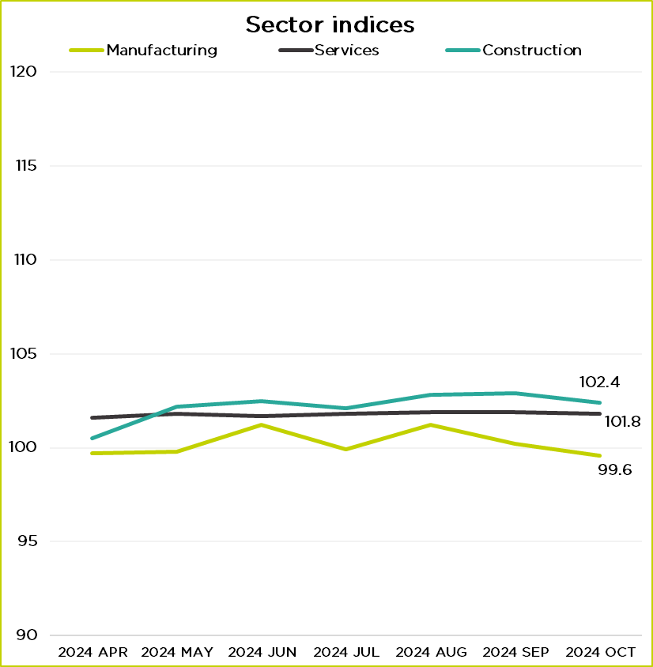
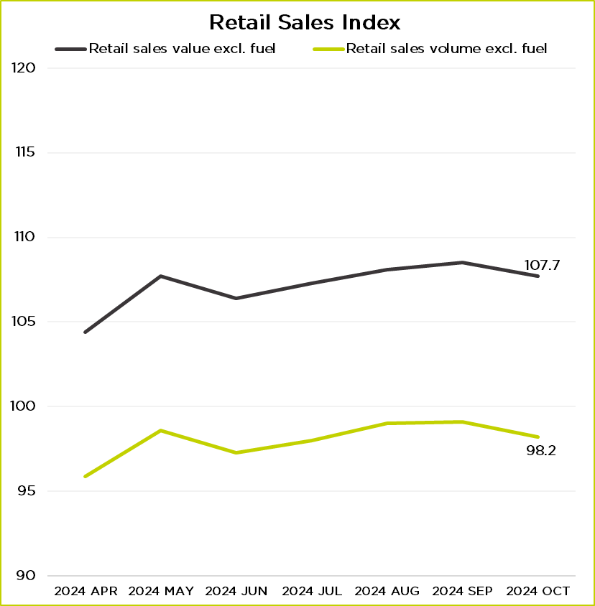
UK Sector Performance
Source: ONS
Source: ONS
#GMEconomics

Slide 10
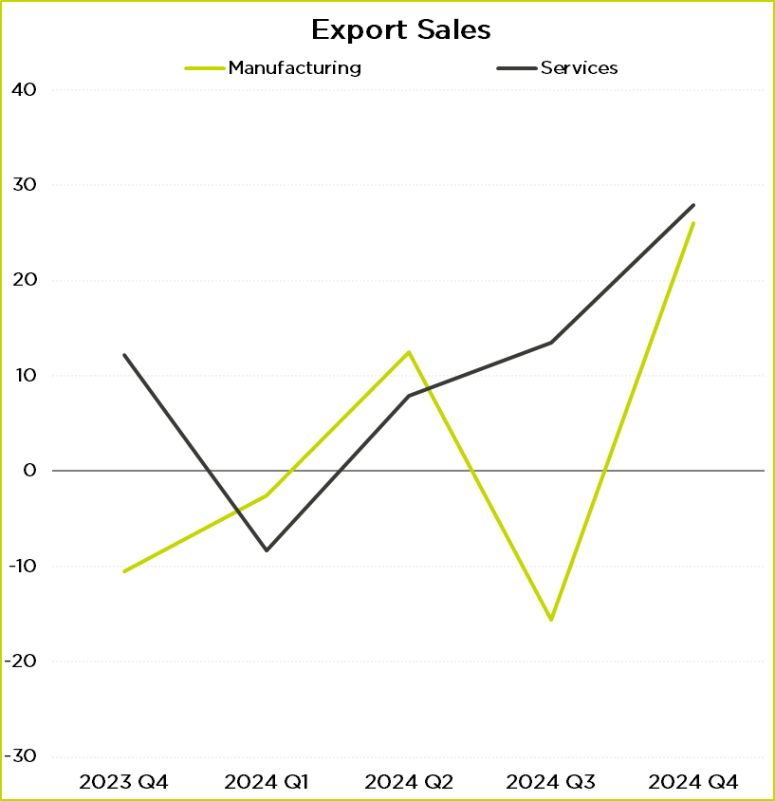
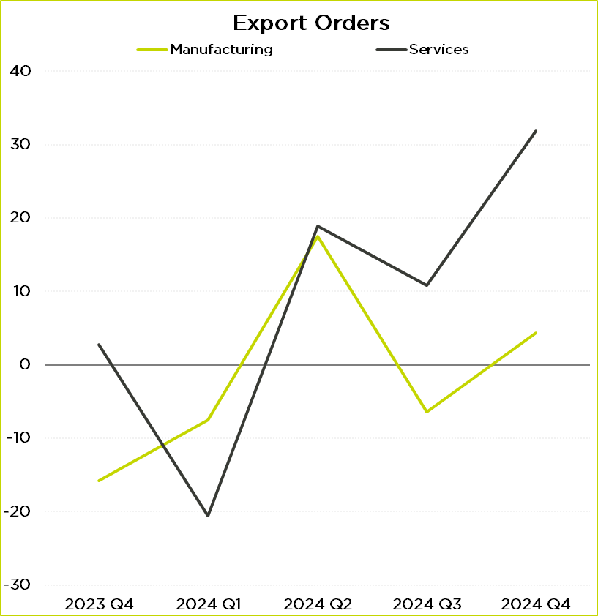
Export demand: sectoral
Source: GMCC QES
Source: GMCC QES
#GMEconomics

Slide 11
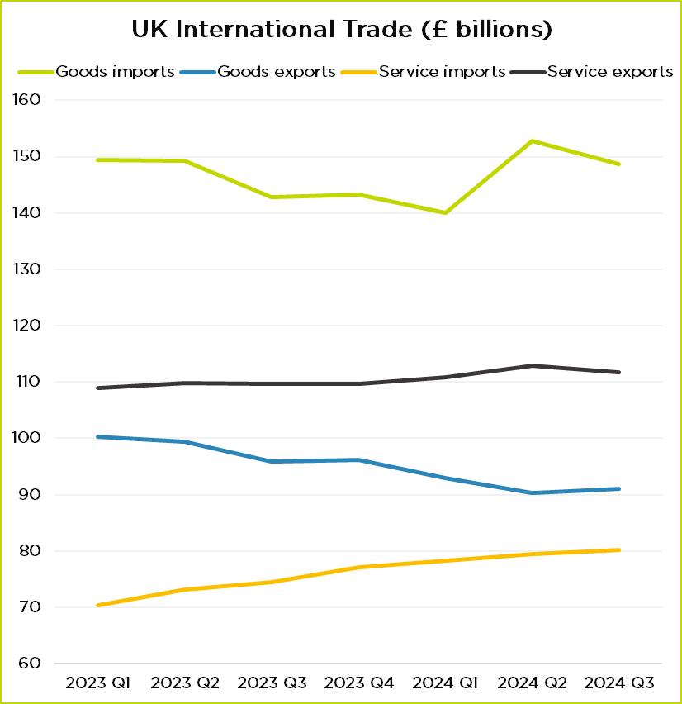
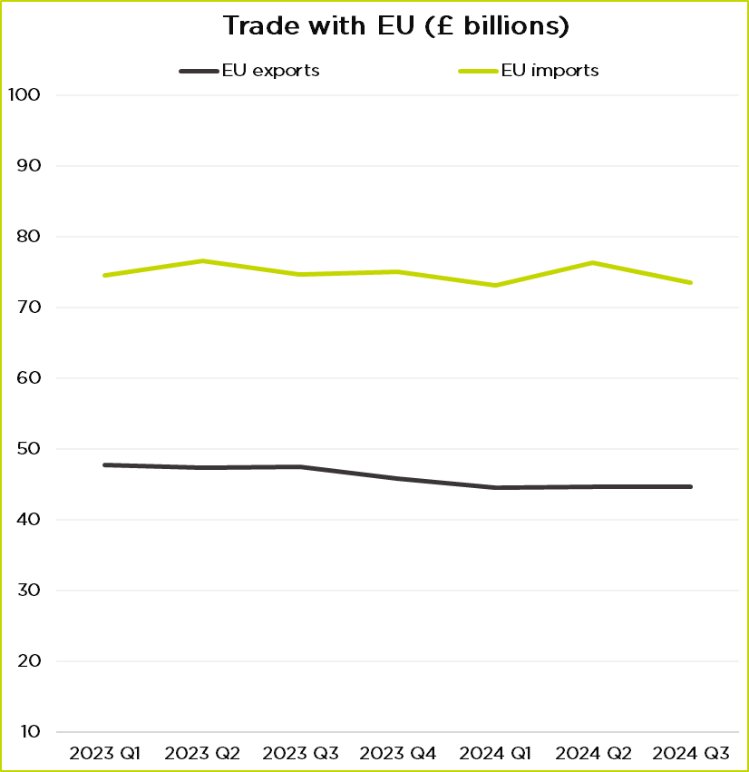
UK International trade
Source: ONS
Source: ONS
#GMEconomics

Slide 12
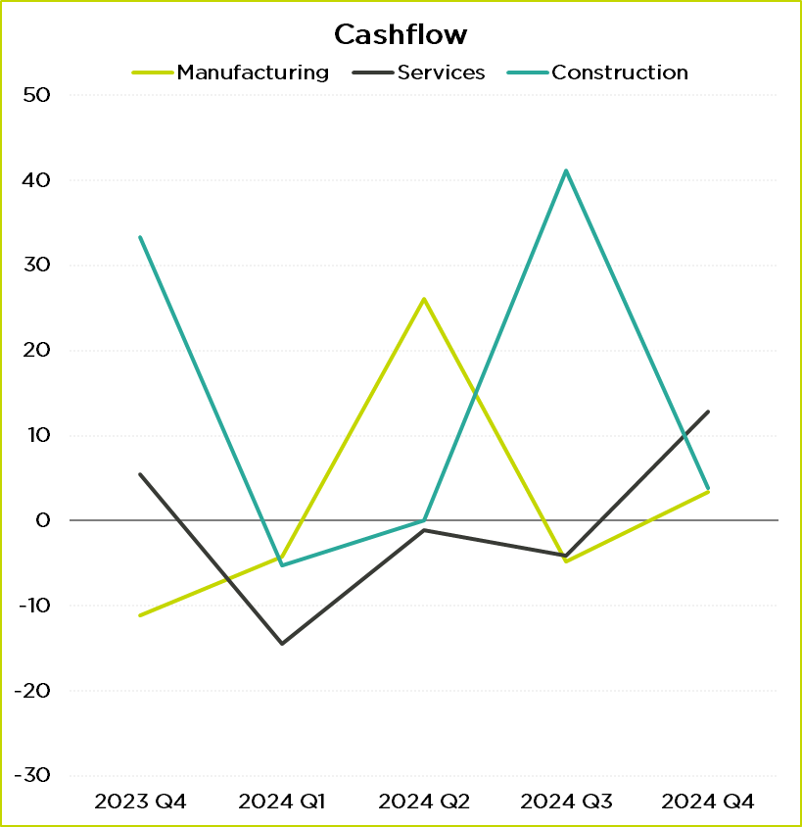
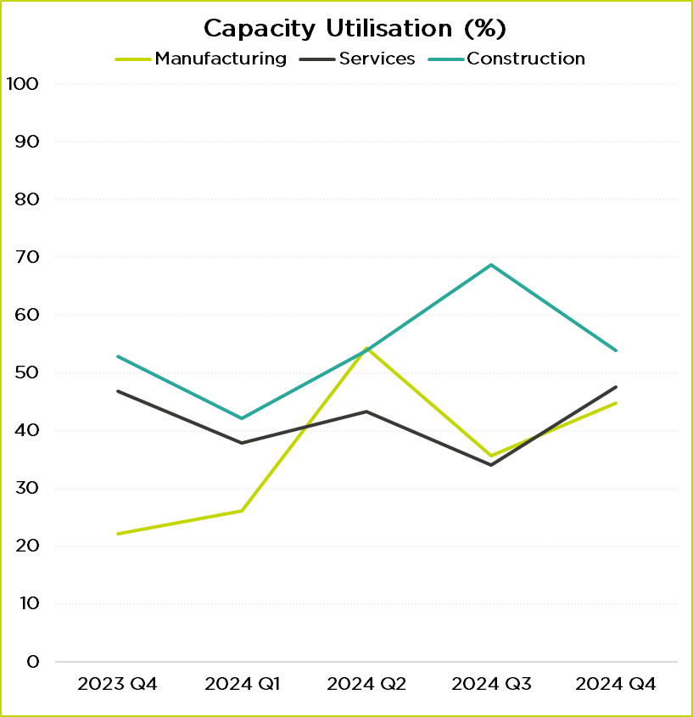
Cashflow & Capacity utilisation
Source: GMCC QES
Source: GMCC QES
#GMEconomics

Slide 13
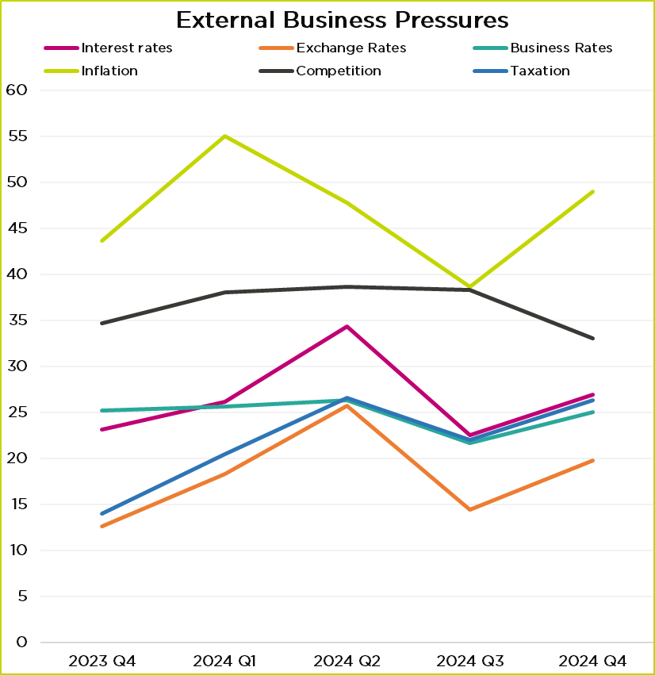
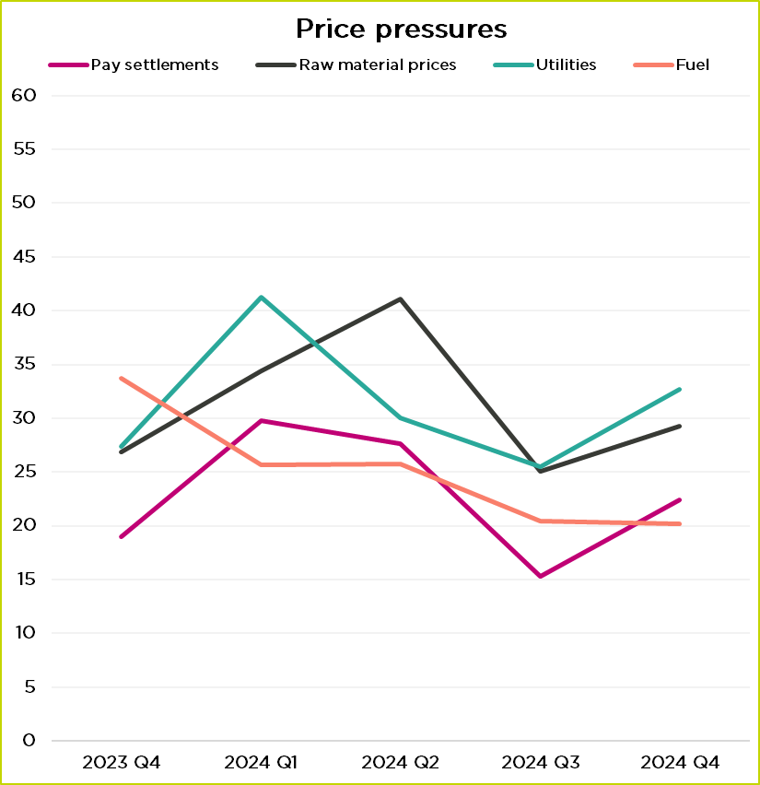
Business Pressures
Source: GMCC QES
Source: GMCC QES
#GMEconomics

Slide 14
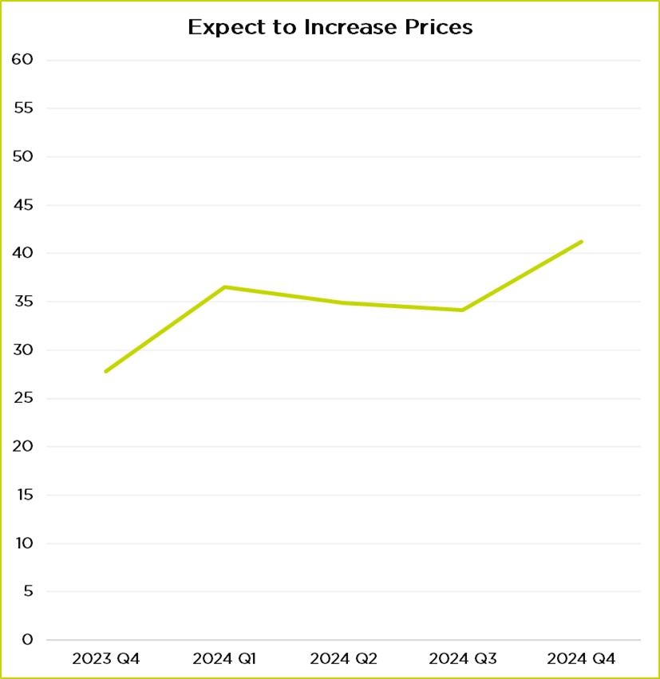
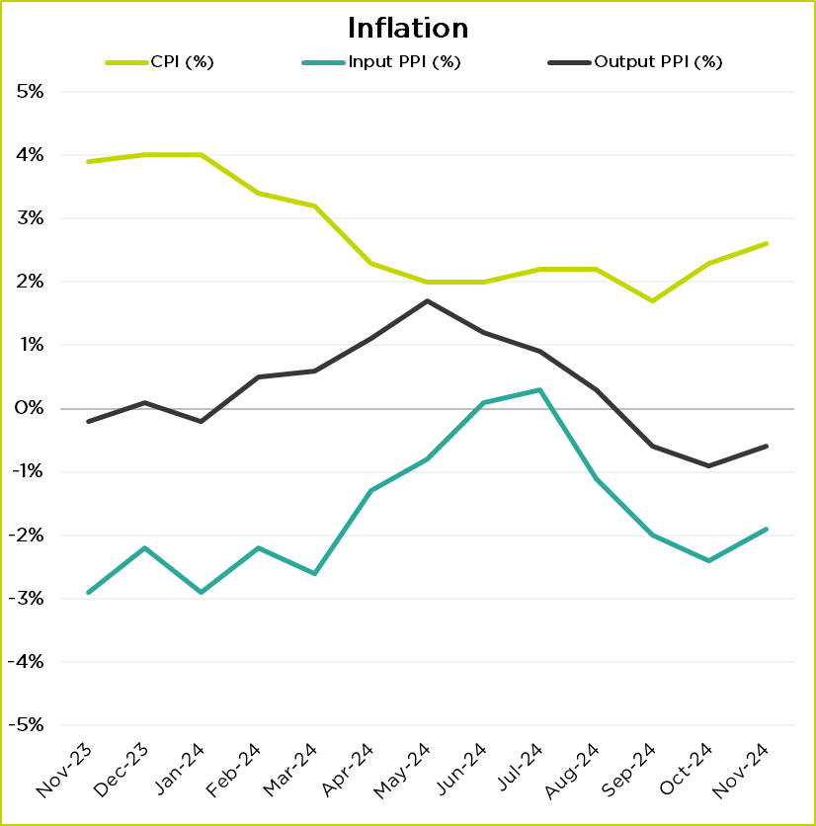
Prices & Inflation
Source: GMCC QES
Source: ONS
#GMEconomics

Slide 15
Business concerns
“The business is US owned. Increase in NLW/NMW and NI is disastrous. US HQ has paused further investment in the UK. We were looking to expand in Manchester but are now exploring US and Asia for a greenfield manufacturing facility.”
“Budget and other pressures on business are a disaster and negate growth and confidence.”
“The budget doesn't feel well thought through. Hoping for growth but no signs from Govt on how this will happen. In the short term we will be significantly financially impacted. Let's hope we survive to take advantage of growth in the years to come. The increase in NLW / NMW is the single biggest price pressure.”
“There is still a lot of uncertainty / lack of understanding of the practical implications of the budget on some (smaller) SME business owners.”
“It is too early to tell. However, this government are competent and have a plan, which is more than can be said about the last government. I am very optimistic that the economy will improve over the longer term.”
“Competition from abroad remains a concern despite our premier product quality. From April 2025 due to this unreasonable budget, and as we cannot raise our prices, we are looking at losing at least 2 people.”
“US trade barriers proposed by Trump may slow the global economy.”
Source: GMCC QES
#GMEconomics

Slide 16
Summary & GDP Forecast
The employer NI rise in the Autumn Budget, combined with proposed increases in NLW / NMW, adds cost pressures for many businesses.
Inflation is expected to remain higher than the target 2%. Energy bills are set to rise again in January.
Devolution white paper focuses on local economic growth.
Forecast growth for 2024 is 0.7% to 1% and 0.2% to 0.5% for Q3.
Interest rates are going down: the Fed cut rates by 0.5%, ECB by 0.25% while the BoE held rates at 5%.
Wage inflation is expected to continue into 2025 putting further pressure for price increases and higher inflation.
Early reports indicate that retail sales declined in November despite discounting and Black Friday sales. Consumer confidence remains low.
#GMEconomics

Slide 17
What does this mean for Greater Manchester?

Slide 18
Thank you!
Panel discussion / Q&A
#GMEconomics

Slide 19
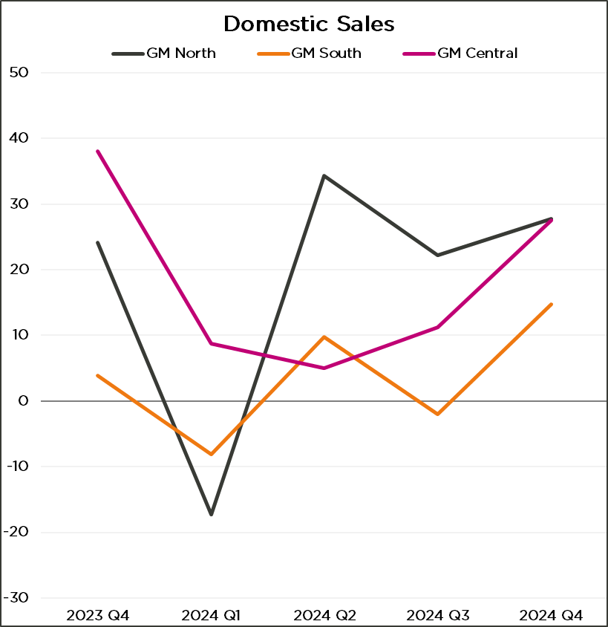
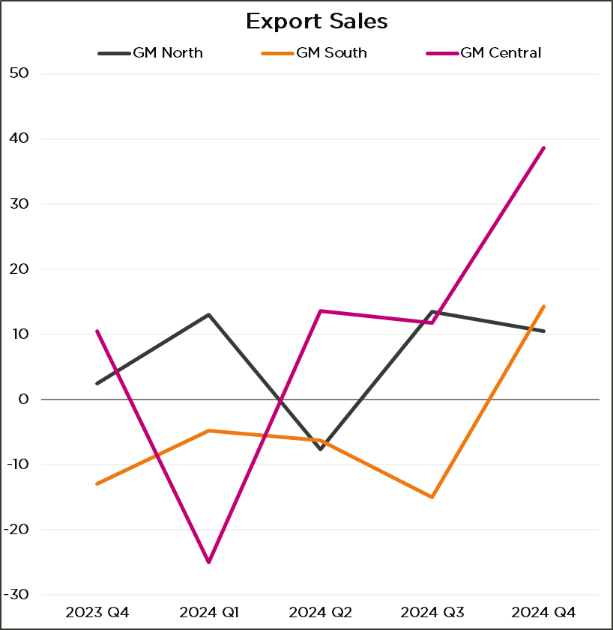
Customer Demand: sub-regional
Source: GMCC QES
Source: GMCC QES
#GMEconomics

