Slide 1


GM Quarterly Economic Briefing Q1 2025
Subrahmaniam Krishnan-Harihara
Deputy Director - Research & Information Systems GM Chamber
27th March 2025

Slide 2
Welcome & Introduction
Quarterly Economic Briefing
Emma Holt, President, GM Chamber
QES presentation
Subrahmaniam Krishnan-Harihara, Deputy Director – Research & Information Systems
Allan Allison, VP of Apprenticeships, QA
Martin O’Shea, Partner – Finance, Addleshaw Goddard
Alasdair Rankin, MD, Aitken Turnbull
Chaired by: Emma Holt
Panel discussion and Q&A
#GMEconomics for tweets

Slide 3
What is the Quarterly Economic Survey (QES)?
The Greater Manchester QES is part of the UK’s largest and most reliable business confidence survey
GM Chamber administers the survey in GM and co-ordinates the North West QES, which goes to the BCC.
National QES results are used by the likes of HM Treasury, Bank of England and OECD for decision making.
GM QES is the primary source of economic intelligence in Greater Manchester.
The findings are presented to Greater Manchester Combined Authority's Economic Resilience Group and the 10 councils in GM for local decision making.
From the QES results, we calculate the GM Index^{TM,} a composite economic indicator for the GM Economy.
#GMEconomics

Slide 4
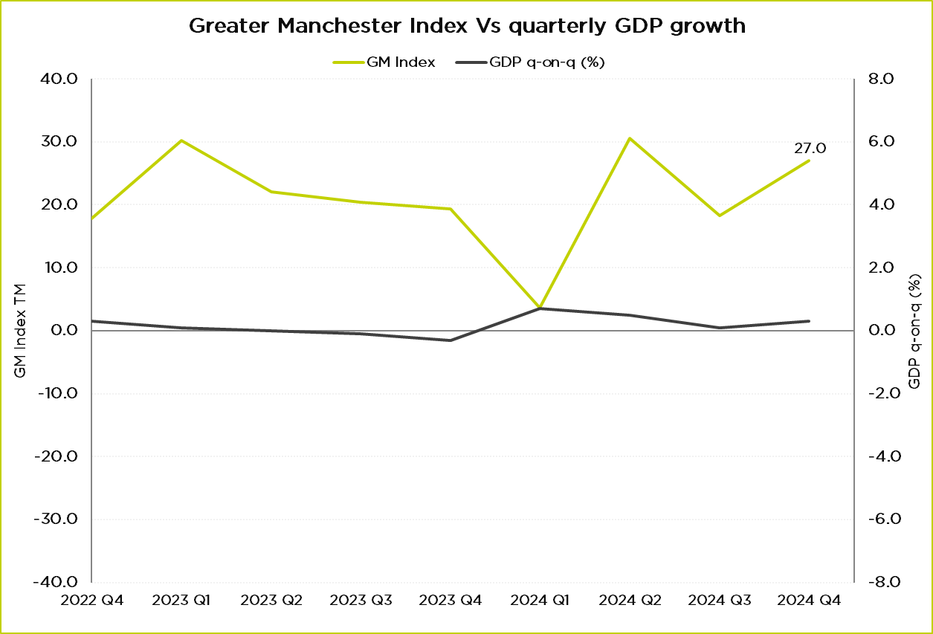
Where were we in Q4 2024?
GM Index in Q4 2024: 27.0
Improvement in both domestic and international demand
Declining business confidence
Q4 growth in GDP of 0.1% led by monthly growth of 0.4% in December.
2024 GDP growth: 0.8%
Source: GMCC QES, ONS GDP Quarter on Quarter growth: CVM SA %
#GMEconomics

Slide 5
Business concerns – Q1 2025
“The changes to NI are likely to be very difficult to absorb and will definitely hold back expansion.”
“NI increase will add £110K to our pay bill this year alone.”
“ERS NIC increases will affect next year. Probably cause inflation. We will increase prices to pass to end customer rather than reduce salaries.”
“Feels like every time there's some positivity, something happens in the macroeconomic environment to counter it. Frustrating, as it feels like the demand is there, but not the confidence to act on it.”
“Business confidence seems to have collapsed.”
“Complete unknown with world events so volatile and UK government unsure of itself.”
“The effect of Brexit has increased our shipping costs dramatically and internal labour costs.”
“Tier one banks are unable to support when filing accounts showing weak profits. Everyone goes through cycles.”
Source: GMCC QES
#GMEconomics

Slide 6
Spring Statement
Measure | Details | Impact
Welfare Cuts and Reforms | 50% cut to Universal Credit health element for new claimants (then frozen); standard allowance rises from £92/week (2025/26) to £106/week (2029/30). | Saves £4.8 billion by 2029/30 and allows the government to invest
Defence Spending Increase | £2.2 billion extra for 2025/26; 10% of equipment budget for innovative tech (e.g., drones, AI); £400 million protected innovation budget. | Extra £2.2 billion in 2025/26, rising to 2.5% of GDP from 2026/27
Tax Avoidance Crackdown | New measures to increase tax fraud charges by 20% annually; targets £7.5 billion total revenue by 2029/30. | £1 billion extra in 2025/26.
Fiscal Adjustments | Fiscal rules met two years early; spending growth cut from 1.3% to 1.2% above inflation; deficit to surplus by 2029/30. | £14 billion fiscal headroom restored.
Growth and Planning Reforms | Planning reforms to boost GDP by 0.2% (£6.8 billion) by 2029/30; supports 1.5 million homes and projects like Heathrow's third runway. | 0.4% GDP boost over a decade.
Household Income Boost | Real household disposable income to grow faster; households £500 better off annually by decade's end. | Help consumer spending
Civil Service reform and public spending cuts | Day-to-day spending growth cut from 1.3% to 1.2% above inflation, potential 5% efficiency savings across departments and potential real-terms cuts of estimated 7% in non-protected departments. | 10,000 civil jobs potentially cut by 2029/30.
Apart from the announcements on house building and defence spending, there weren’t major growth orientated measures.
No long-term vision yet, especially for regional growth
Net zero ambition scaled down
Source: Spring Statement 2025
#GMEconomics

Slide 7
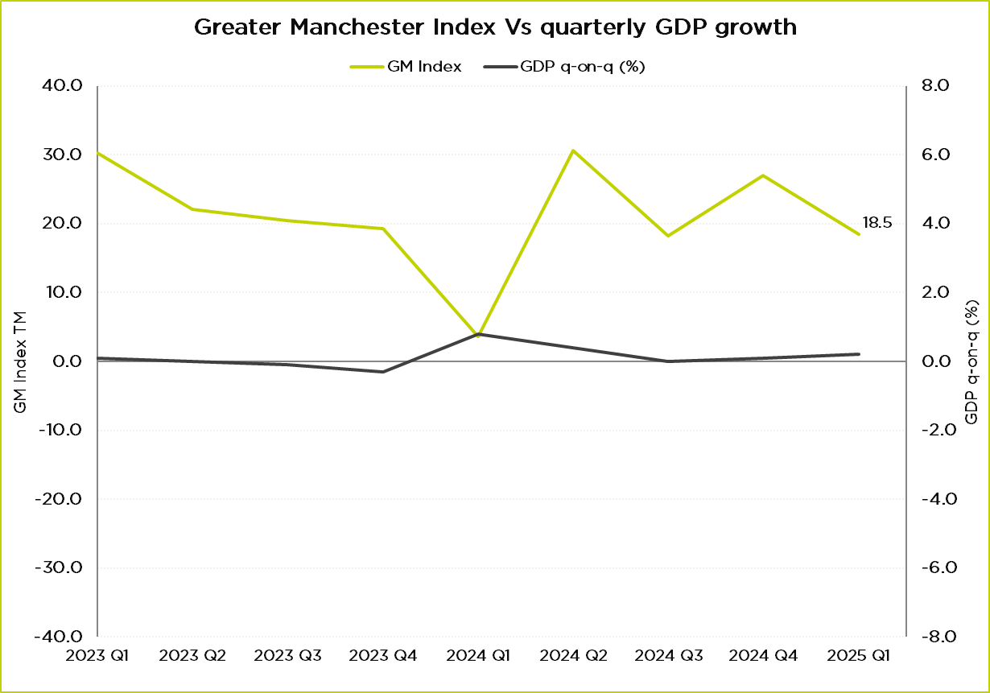
Where are we now?
GM Index in Q1 2025: 18.5
Particular weakening in international and labour demand
0.1% monthly GDP contraction in Jan 2025
Latest PMI indices also show a slowdown
  Services 51
  Manufacturing 46.9
  Construction 44.6
Source: GMCC QES, ONS GDP Quarter on Quarter growth: CVM SA %
#GMEconomics

Slide 8
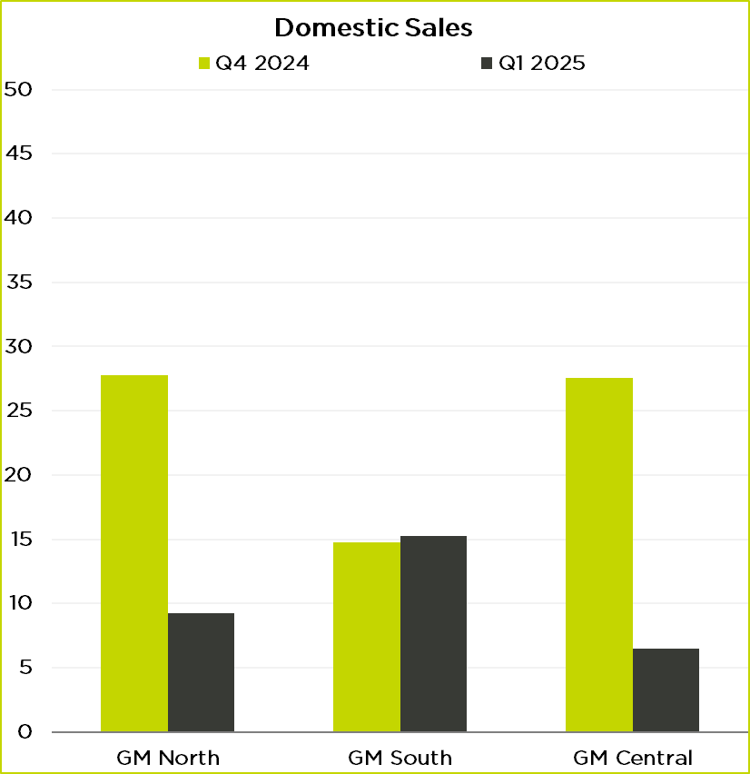
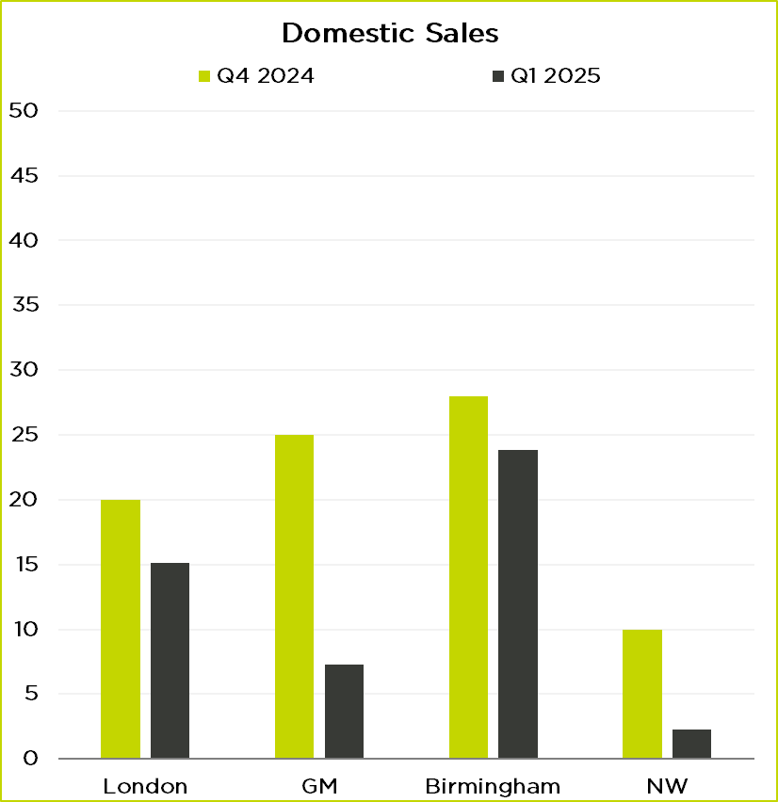
Domestic Demand: sub-regional and regional
Source: GMCC QES
Source: BCC QES
#GMEconomics

Slide 9
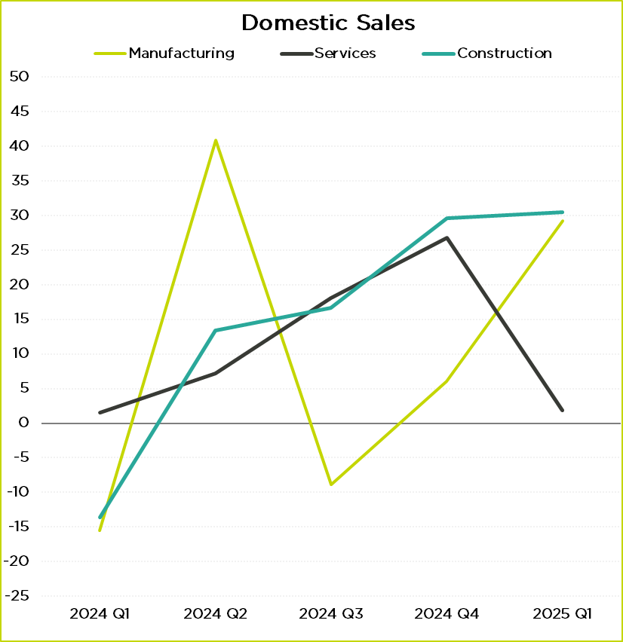
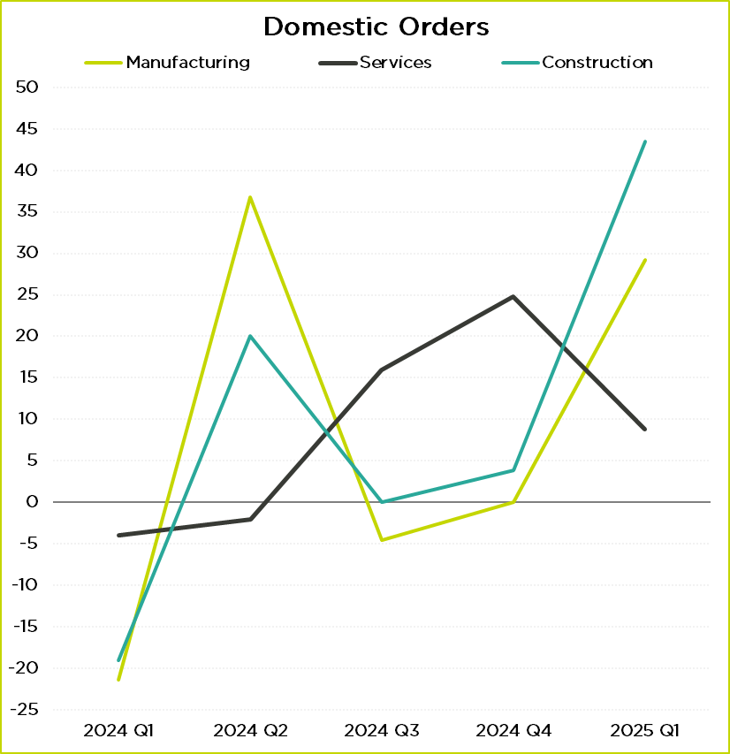
Domestic Demand: sectoral
Source: GMCC QES
Source: GMCC QES
#GMEconomics

Slide 10
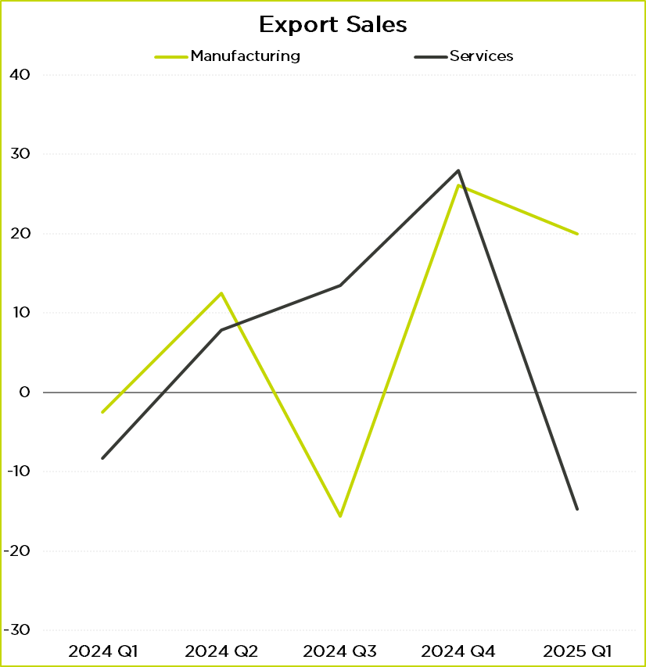
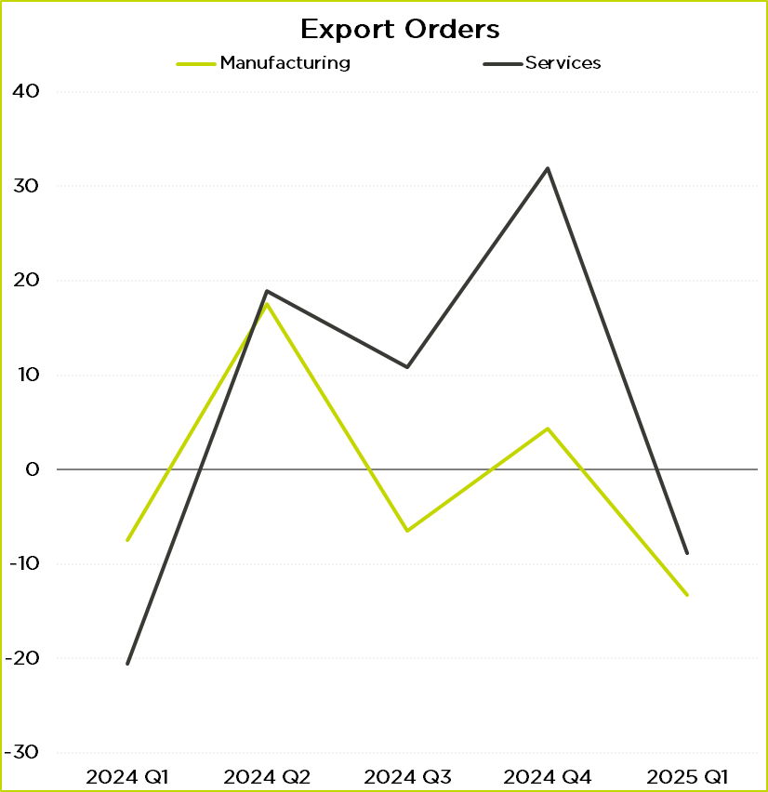
Export demand: sectoral
Source: GMCC QES
Source: GMCC QES
#GMEconomics

Slide 11
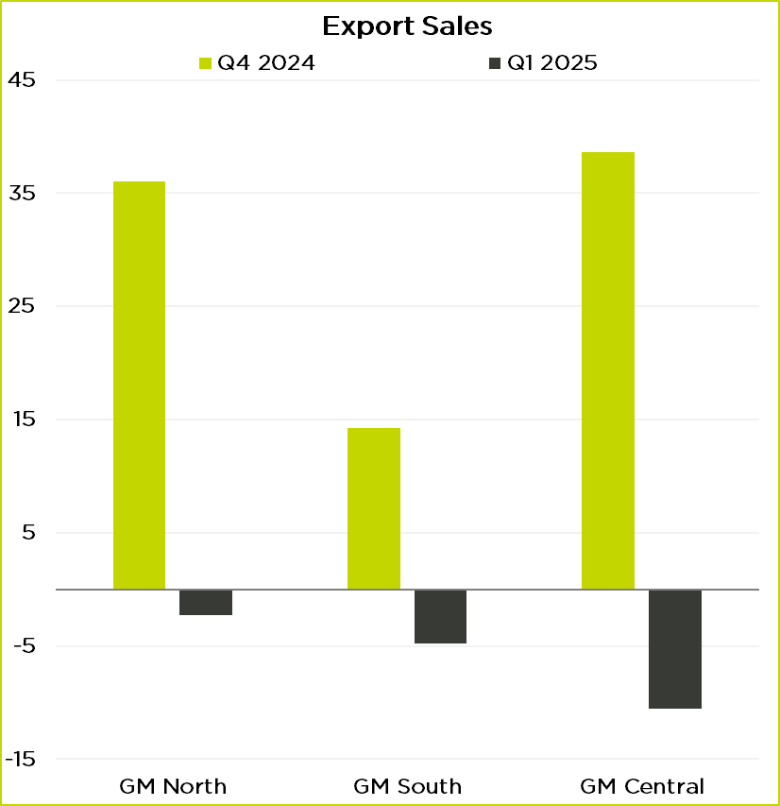
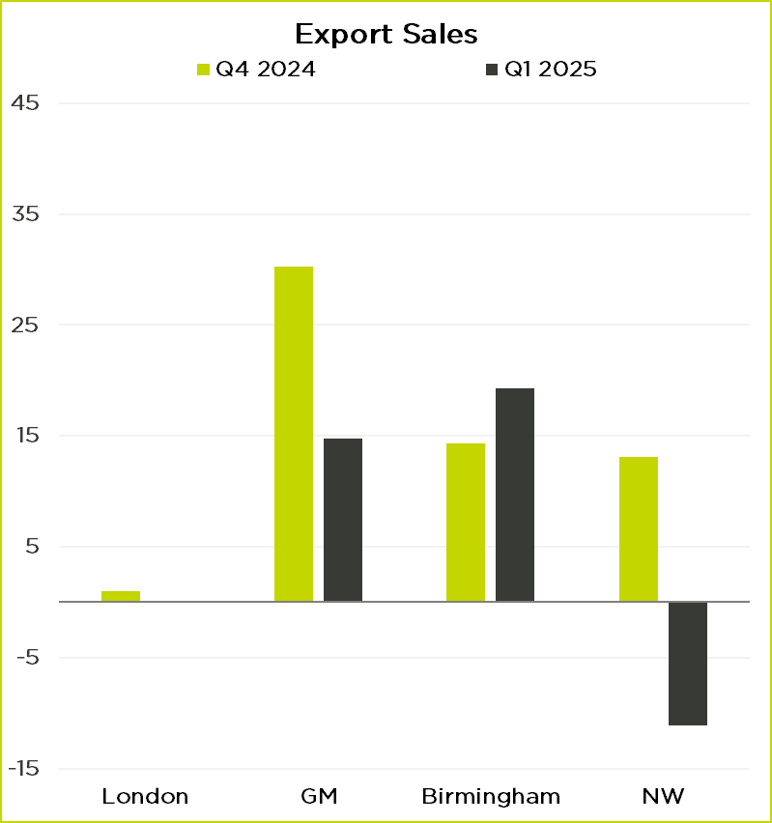
Export Demand: sub-regional and regional
Source: GMCC QES
Source: BCC QES
#GMEconomics

Slide 12
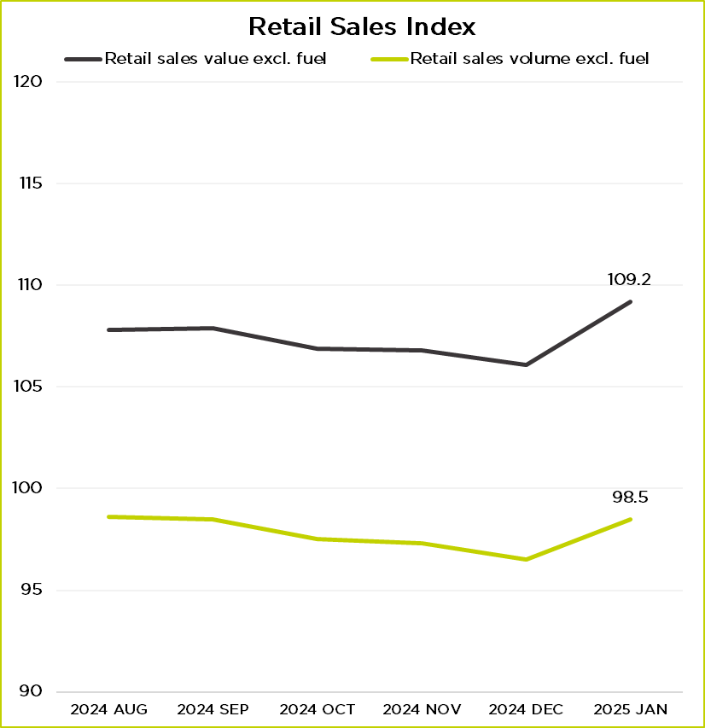
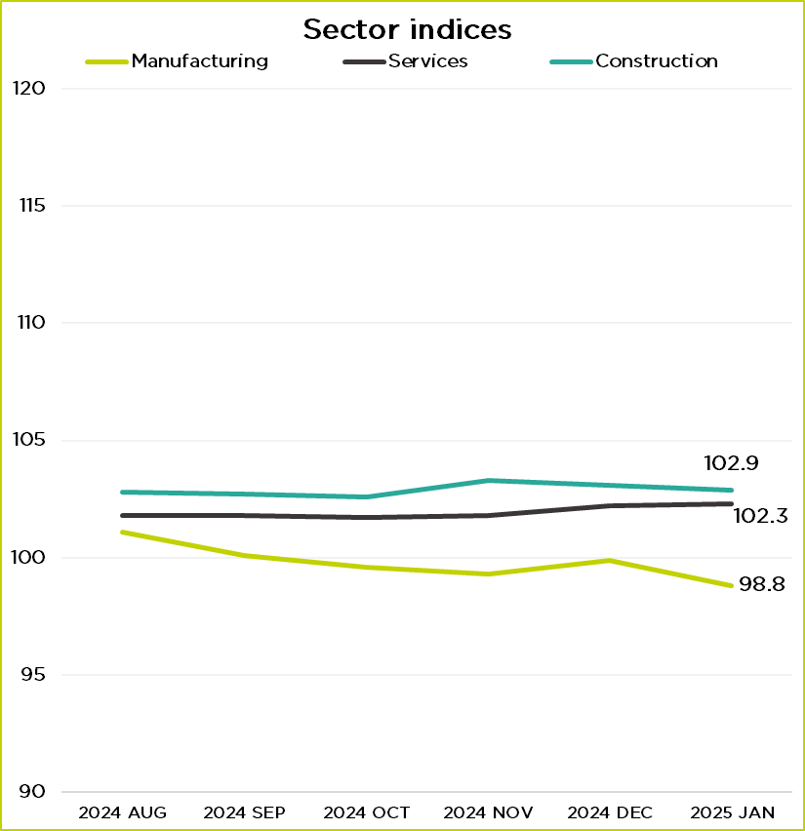
UK Sector Performance
Source: ONS
Source: ONS
#GMEconomics

Slide 13
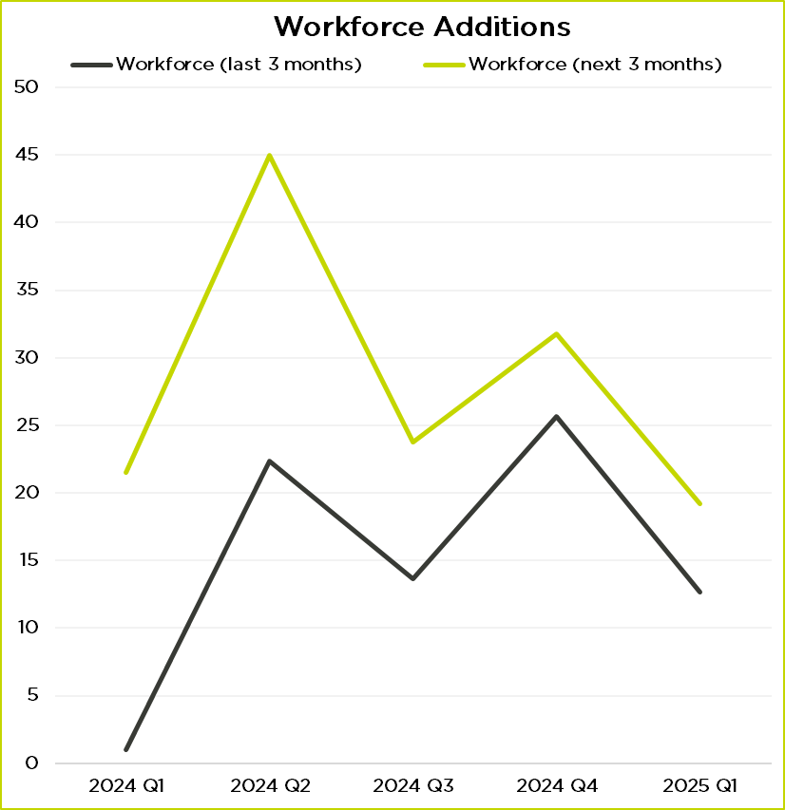
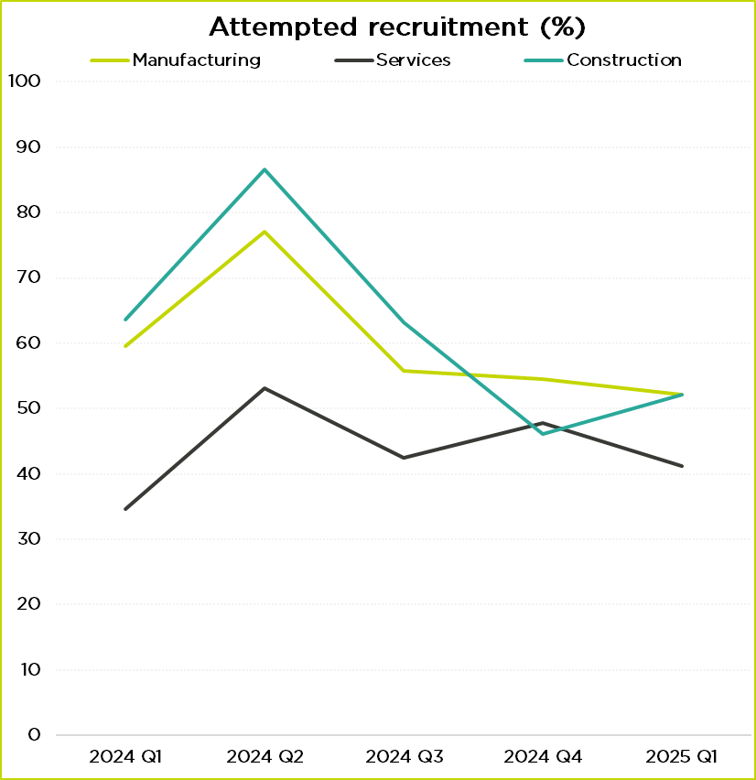
Recruitment
Source: GMCC QES
Source: GMCC QES
#GMEconomics

Slide 14
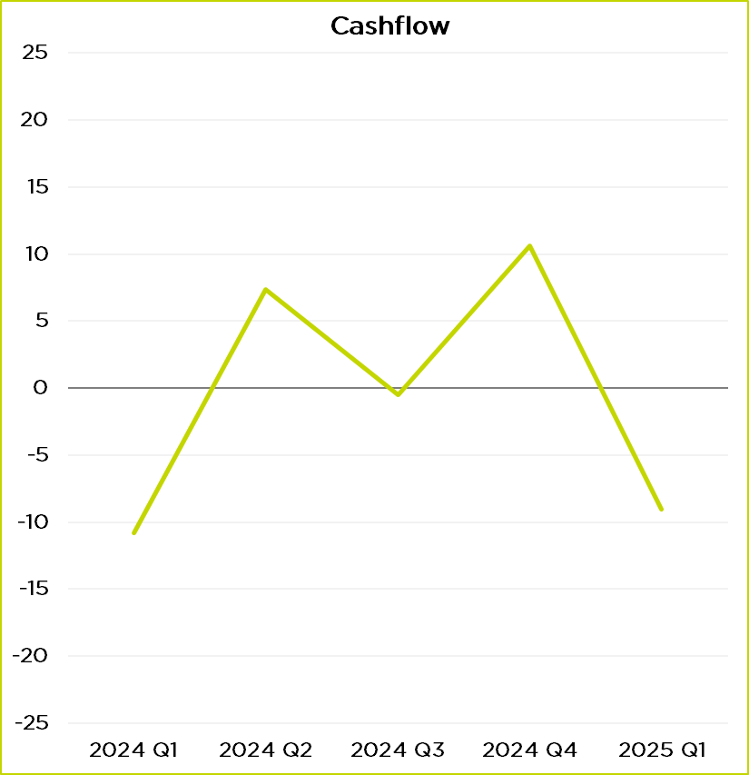
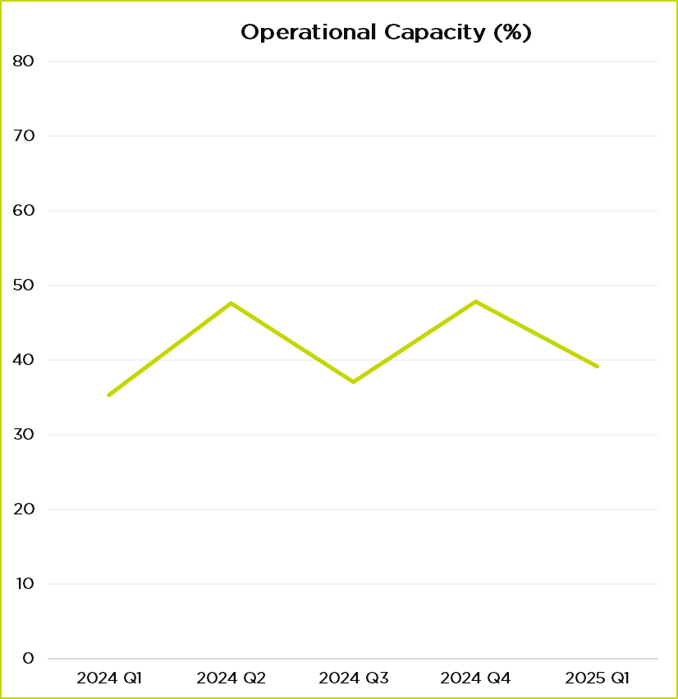
Cashflow & Capacity utilisation
Source: GMCC QES
Source: GMCC QES
#GMEconomics

Slide 15
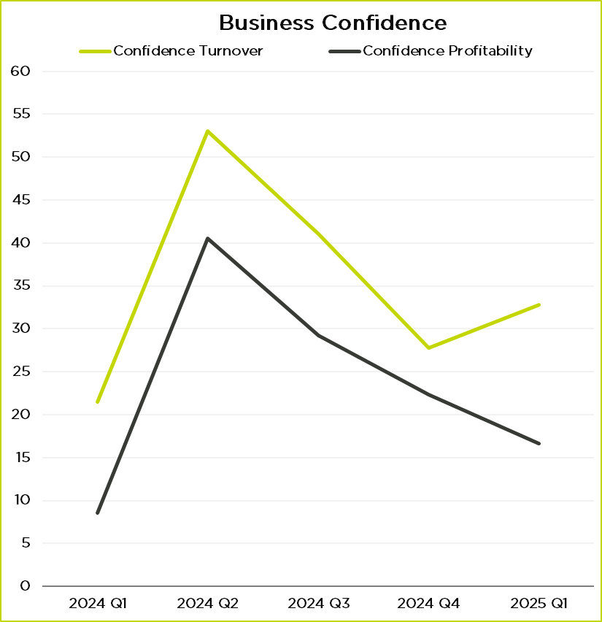
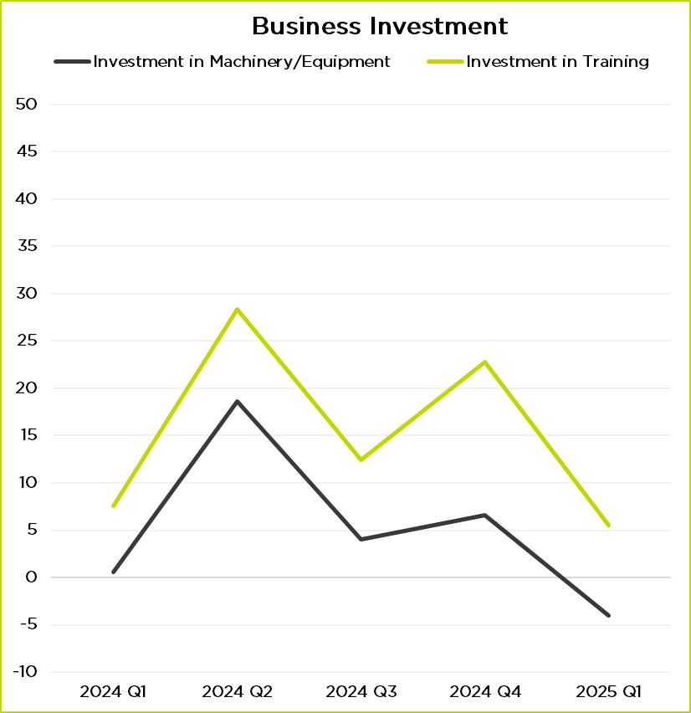
Business Confidence & Investment Prospects
Source: GMCC QES
Source: GMCC QES
#GMEconomics

Slide 16
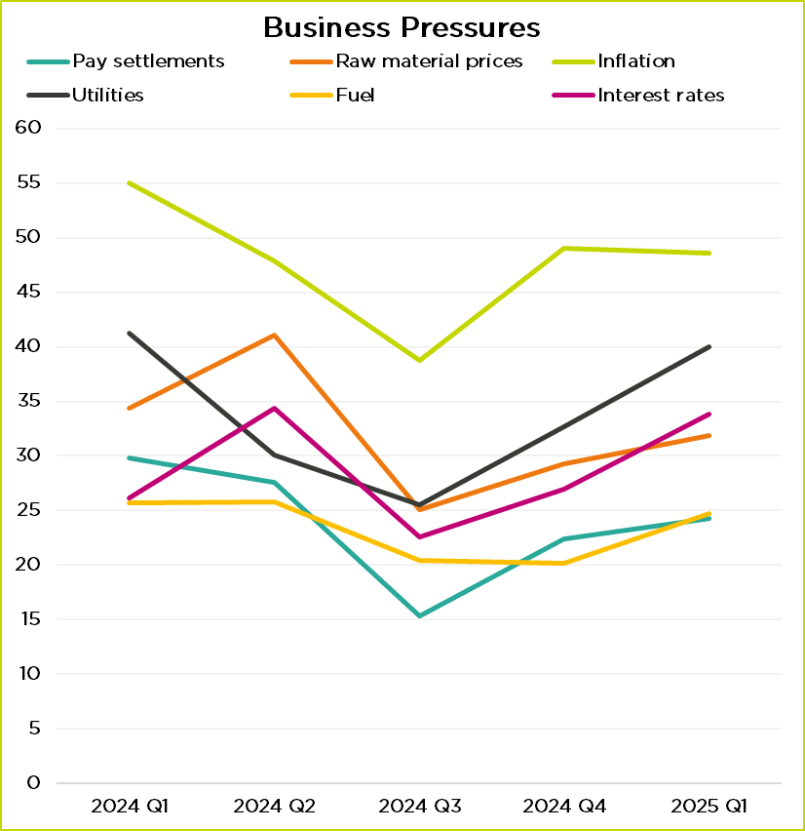
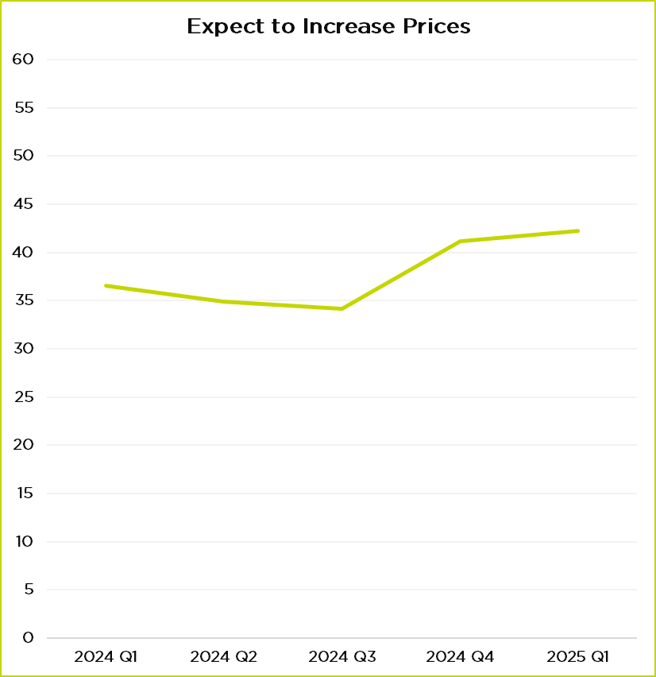
Business Pressures & Prices Increases
Source: GMCC QES
Source: GMCC QES
#GMEconomics

Slide 17
Summary & GDP Forecast
Business confidence has dipped following the rise in employer NIC announced in the Autumn Budget. Wage inflation is likely with upcoming increases in NLW / NMW putting further pressure on headline inflation.
Inflation is stubborn and expected to remain higher than the target 2%.
Integrated settlement to start in April in Greater Manchester
Interest rates are going down slowly: the BoE is cautious and held rates at 4.5%.
Consumer confidence has shown a slight improvement since the end of 2024.
Forecast growth for 2025 is 0.8% to 1.1% and 0.1% for Q1.
#GMEconomics

Slide 18
Panel discussion / Q&A
Allan Allison, VP of Apprenticeships, QA
Martin O’Shea, Partner – Finance, Addleshaw Goddard
Alasdair Rankin, MD, Aitken Turnbull
Chaired by: Emma Holt
#GMEconomics

